Slide 1
SDMS - SPAREPART FLOW

Slide 2
Overview
SDMS - Sparepart module divided into several main sections which are :
Master
Pembelian
Penerimaan
Penjualan
Inventory
Posting
Stock Opname
Utility

Slide 3
SPAREPART : MASTER
Crucial to abandon this section, probably the mastermind of spare part modules

Slide 4
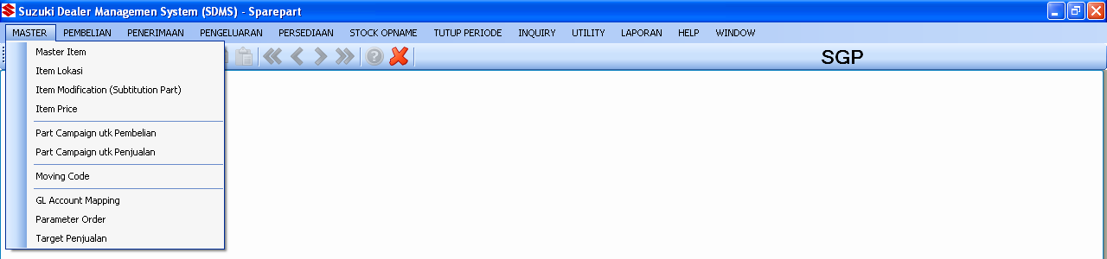
SPAREPART : MASTER
Sparepart master are :
Master Item
Master Item Location
Master Item Modification
Master Item Price
Master Campaign Purchase
Master Campaign Sales
Master Moving Code
Master Account
Master Parameter
Master Sales Target

Slide 5
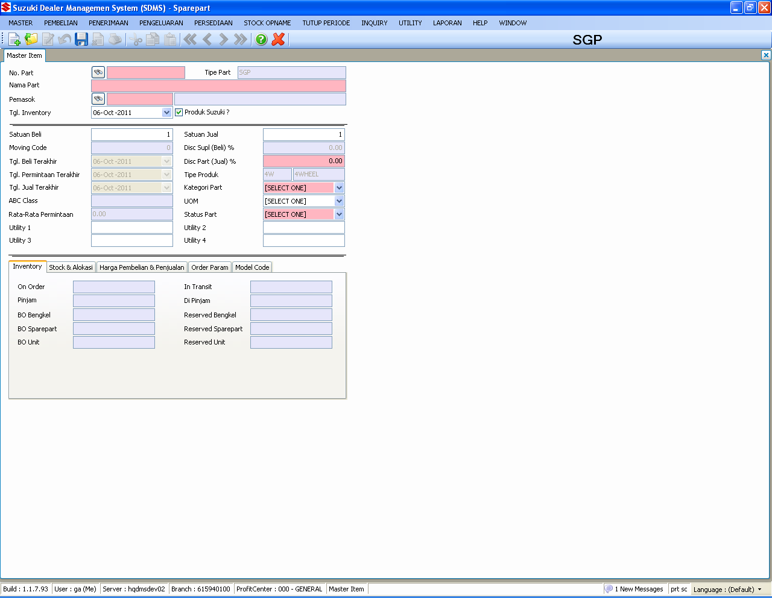
SPAREPART : MASTER
MASTER ITEM
TABLES :
SpMstItems
SpMstItemLoc
SpMstItemInfo
Notes :
Toolbar Save, create a new record for spMstItems and also SpMstItemLoc instantly
Create a new record SpMstItemInfo for new part that not exist in spMstItemInfo
Be sure to check your type of goods before save the new part
Onhand, Allocation, Reserved, Back Order can’t directly inserted from this screen, it should be from background database conversion process
For Conversion, be sure to check BOMInvQty compare to OnHand

Slide 6
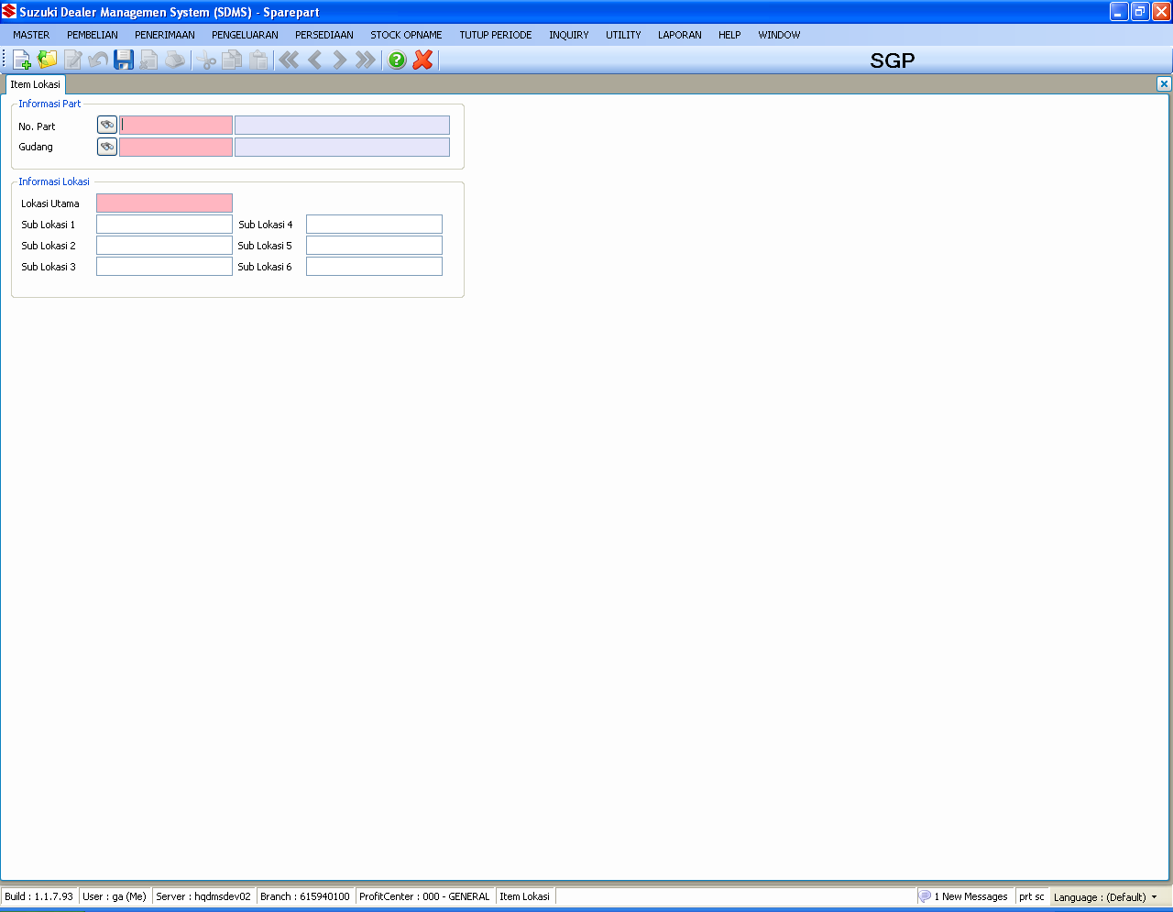
SPAREPART : MASTER
MASTER ITEM LOCATION
TABLES :
SpMstItemLoc

Slide 7
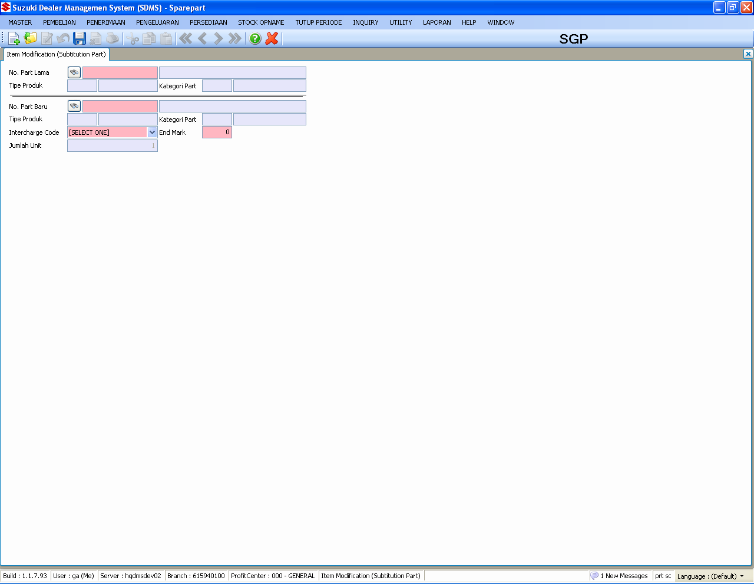
SPAREPART : MASTER
MASTER ITEM MODIFICATION
TABLES :
SpMstItemMod

Slide 8
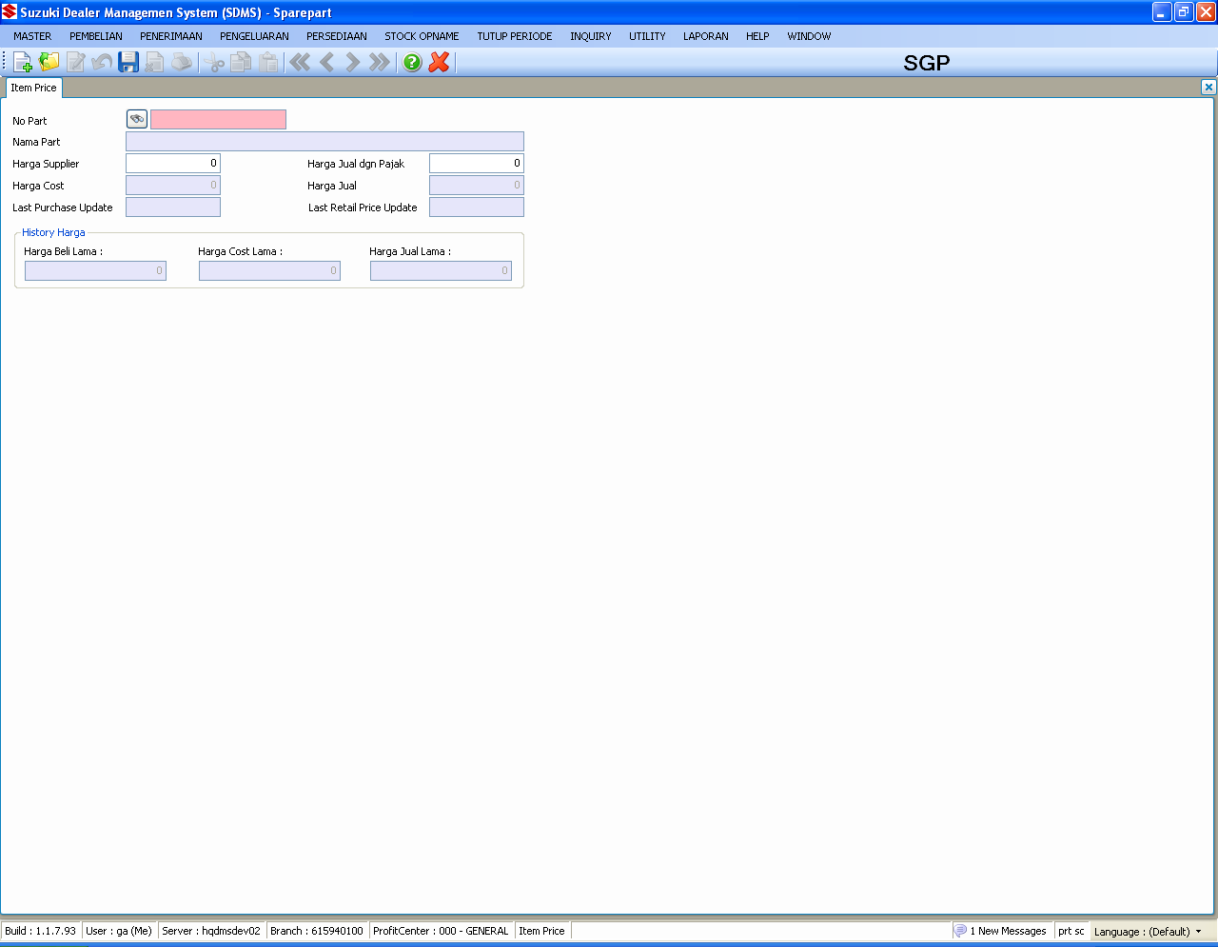
SPAREPART : MASTER
MASTER ITEM PRICE
TABLES :
SpMstItemPrice
SpHstItemPrice
Notes :
All the changes of master item price will go directly in SpHstItemPrice, check SpHstItemPrice if you want to find a evidence of changing price

Slide 9
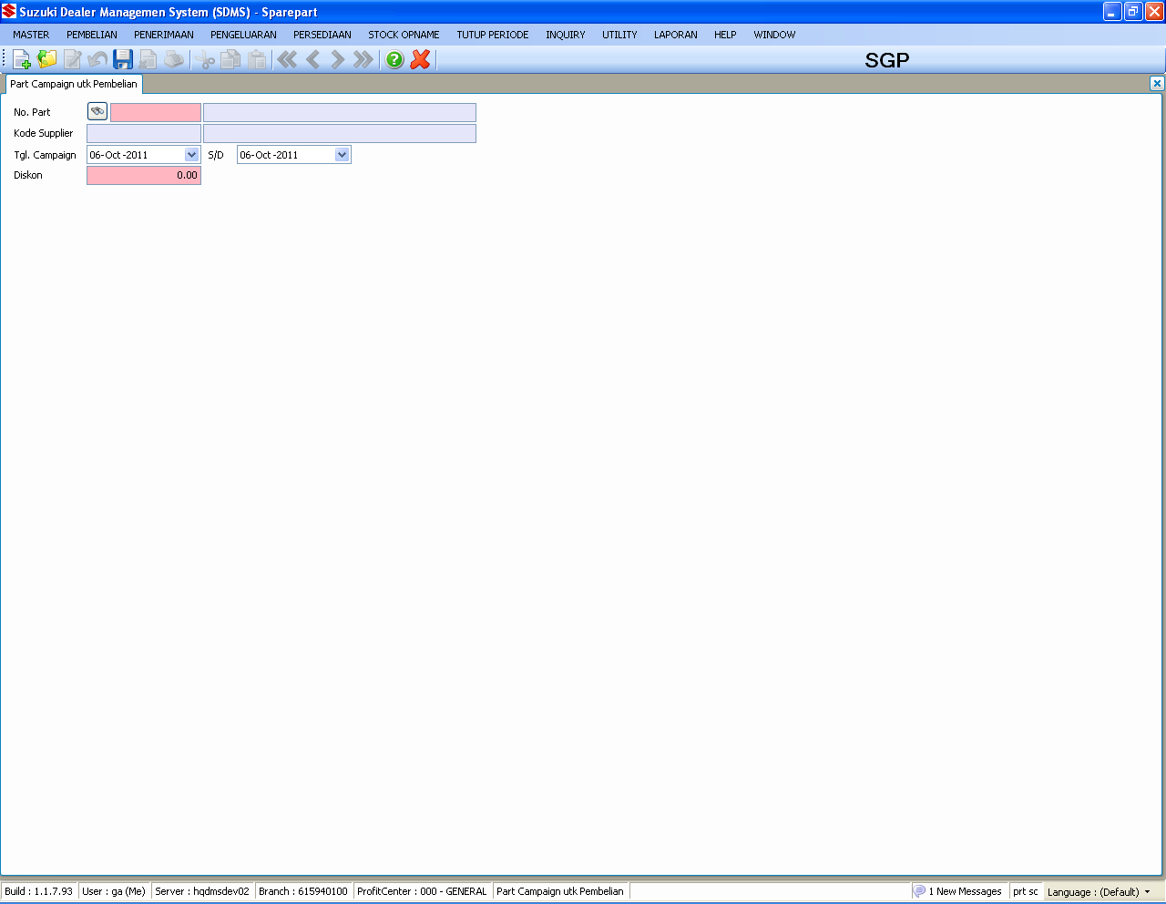
SPAREPART : MASTER
MASTER CAMPAIGN PURCHASE
TABLES :
SpMstPurchCampaign
Notes :
Effected only for purchase order process based on part in campaign

Slide 10

SPAREPART : MASTER
MASTER CAMPAIGN SALES
TABLES :
SpMstSalesCampaign
Notes :
Effected only for sales order process based on part in campaign

Slide 11
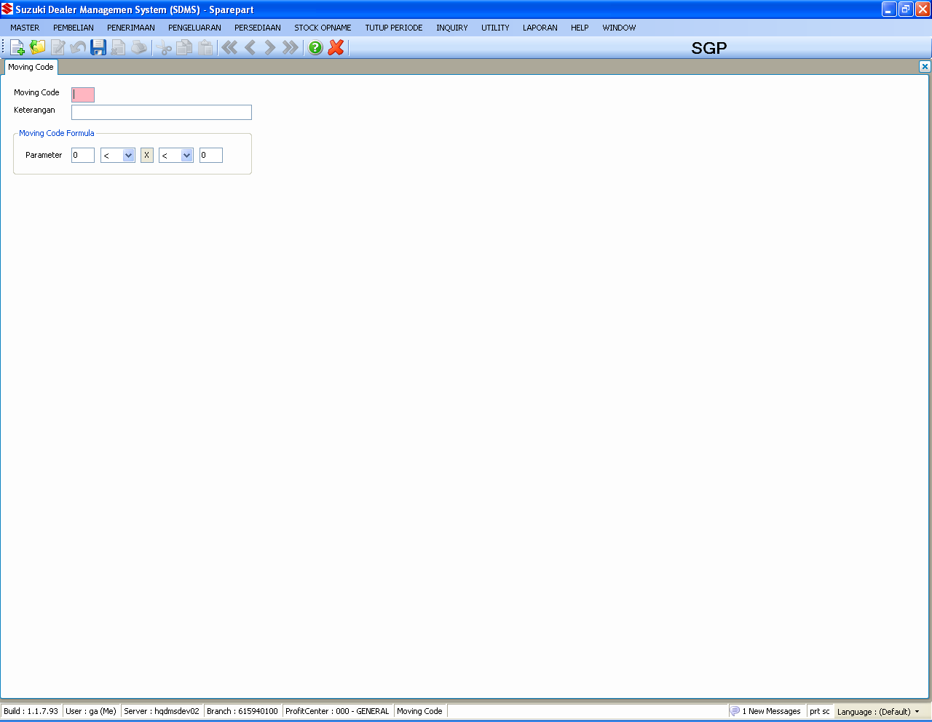
SPAREPART : MASTER
MASTER MOVING CODE
TABLES :
SpMstMovingCode

Slide 12
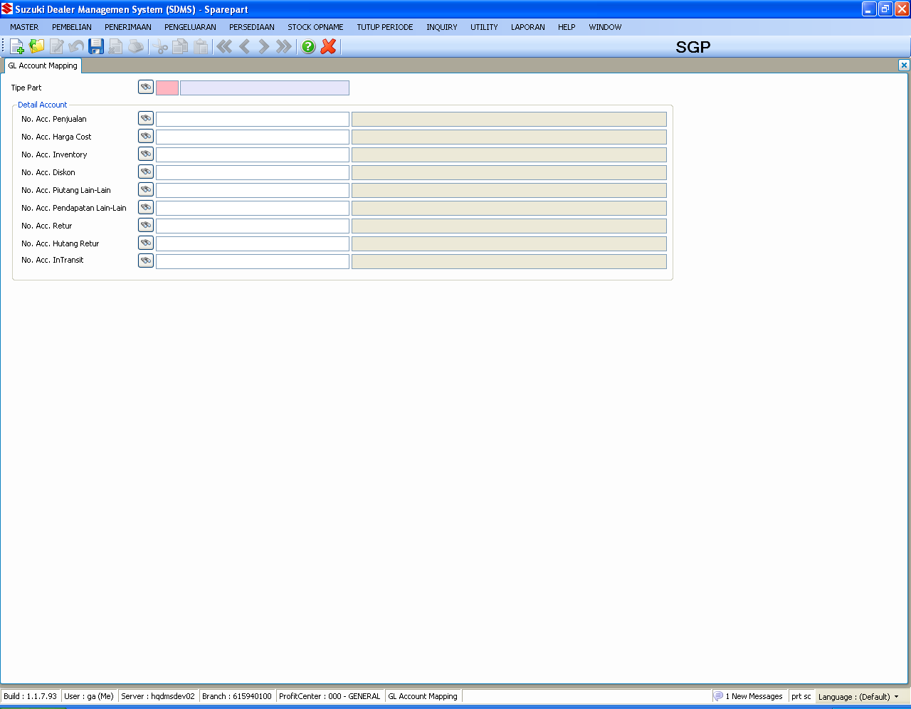
SPAREPART : MASTER
MASTER ACCOUNT
TABLES :
SpMstAccount
Notes :
Even its not mandatory, be sure to fill all the account

Slide 13
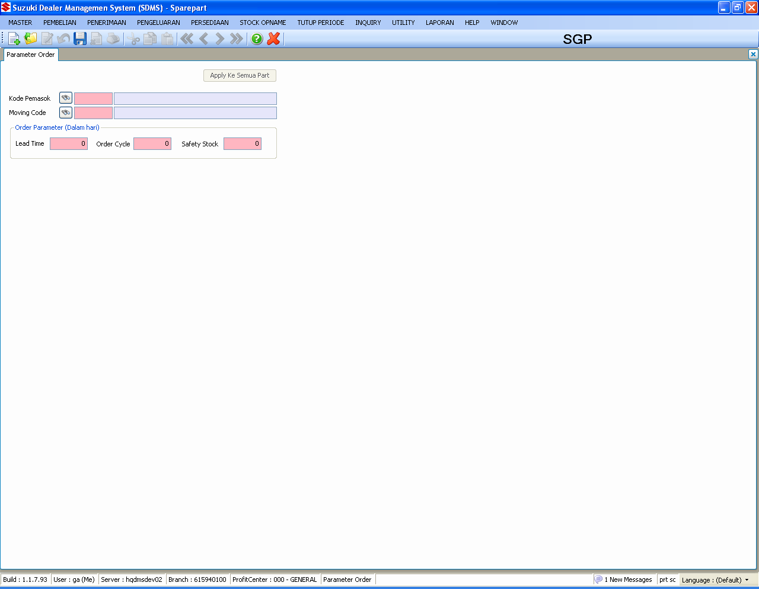
SPAREPART : MASTER
MASTER PARAMETER
TABLES :
SpMstOrderParam

Slide 14
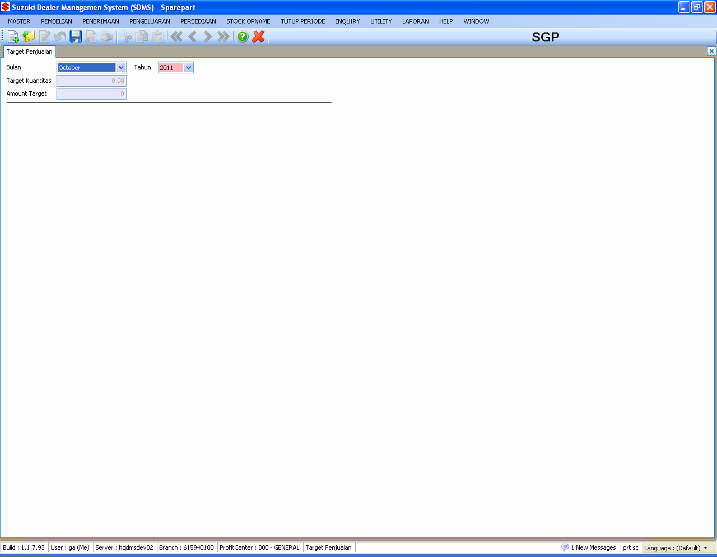
SPAREPART : MASTER
MASTER SALES TARGET
TABLES :
SpMstSalesTarget

Slide 15
SPAREPART : PEMBELIAN
Handle the purchasing process

Slide 16
SPAREPART : PEMBELIAN
FLOWCHART
Suggestion Order
Purchase Order
Maintain
On order
NOTE :
Pembelian divided into two main process which are :
Suggestion Order
Purchase Order
Both of these will have the same final results which is purchase order number
Subtitusi

Slide 17
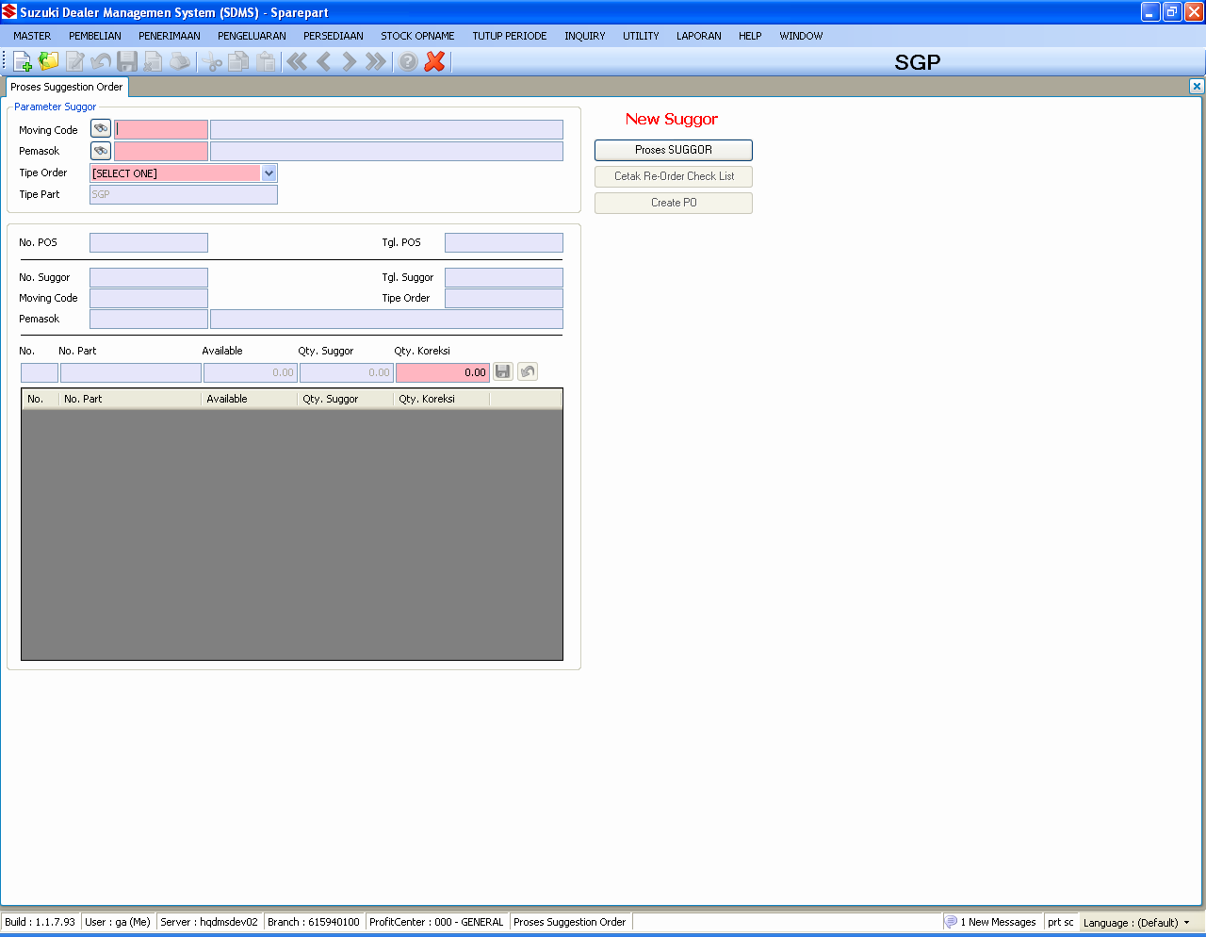
SPAREPART : PEMBELIAN
Suggestion Order (Suggor)
TABLES :
SpMstItems
SpMstItemInfo
SpMstOrderParam
SpMstItemMod
SpTrnSuggorHdr
SpTrnSuggorDtl
SpTrnPPOSHdr
SpTrnPPOSDtl
GnMstDocument

Slide 18
SPAREPART : PEMBELIAN
Suggestion Order (Suggor) – Continued 1
Notes :
Rumus Safety Stock
Demand Average * Safety Stock Point
Rumus Order Point
(Demand Average * (lead time point + ordercycle point )) * Safety Stock
Rumus Total Stock
(Onhand + OnOrder + Intranstit) – (All Allocation + All Reserved + All Back Order)
If > 0 then x
If <= 0 then 0
Rumus Suggor Quantity
Order Point – Total Stock

Slide 19
SPAREPART : PEMBELIAN
Suggestion Order (Suggor) – Continued 2
Notes :
FUNCTION : ORDERINGBLL
public static bool ProcessSuggor(SysUser user, SpTrnPSUGGORHdr record, ref DataSet dsSuggor, PostingProgress pb)
decimal dQty = Convert.ToDecimal(row["DemandQty"]);
decimal ltp = Convert.ToDecimal(row["LeadTime"]);
decimal ocp = Convert.ToDecimal(row["OrderCycle"]);
decimal ssp = Convert.ToDecimal(row["SafetyStock"]);
decimal onHand = Convert.ToDecimal(row["OnHand"]);
decimal onOrder = Convert.ToDecimal(row["OnOrder"]);
decimal inTransit = Convert.ToDecimal(row["InTransit"]);
decimal spAlloc = Convert.ToDecimal(row["AllocationSP"]);
decimal srAlloc = Convert.ToDecimal(row["AllocationSR"]);
decimal slAlloc = Convert.ToDecimal(row["AllocationSL"]);
decimal spBO = Convert.ToDecimal(row["BackOrderSP"]);
decimal srBO = Convert.ToDecimal(row["BackOrderSR"]);
decimal slBO = Convert.ToDecimal(row["BackOrderSL"]);
decimal spReserv = Convert.ToDecimal(row["ReservedSP"]);
decimal srReserv = Convert.ToDecimal(row["ReservedSR"]);
decimal slReserv = Convert.ToDecimal(row["ReservedSL"]);
decimal dAvg = oSpMstItems == null ? 0 : oSpMstItems.DemandAverage;
decimal ssQty = (dAvg * ssp);
decimal orderPoint = (dAvg * (ltp + ocp)) + ssQty;
decimal totalStock = (onHand + onOrder + inTransit -
(spAlloc + srAlloc + slAlloc + spBO + srBO + slBO +
spReserv + srReserv + slReserv)) > 0 ?
(onHand + onOrder + inTransit -
(spAlloc + srAlloc + slAlloc + spBO + srBO + slBO +
spReserv + srReserv + slReserv)) : 0;
decimal suggorQty = orderPoint - totalStock;

Slide 20
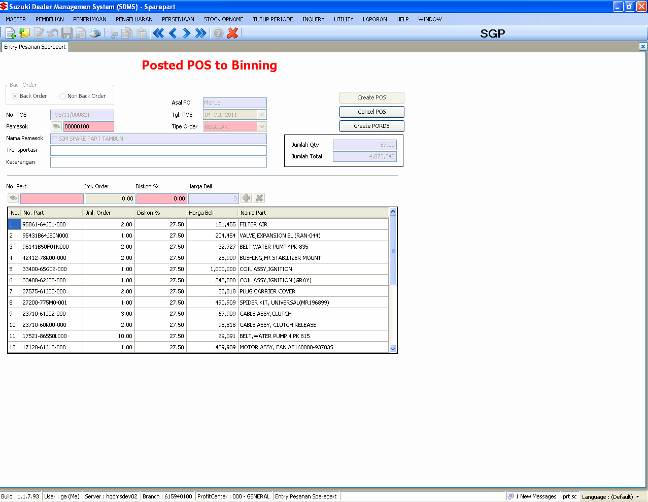
SPAREPART : PEMBELIAN
Purchase Order
TABLES :
SpMstItems
SpMstItemPrice
SpMstItemInfo
GnMstSupplier
GnMstSupplierProfitCenter
SpTrnPOrderBalance
SpTrnPPOSHdr
SpTrnPPOSDtl
SpMstPurchCampaign
SysParameter
GnMstDocument
Notes :
Cancel POS can be done if there aren’t part in selected POS registered in binning process
Create PORDS can be done many times as it likes but only can be proceed in DCS one times, so be sure to check and re-check before sending process (DCS key : POS number)

Slide 21
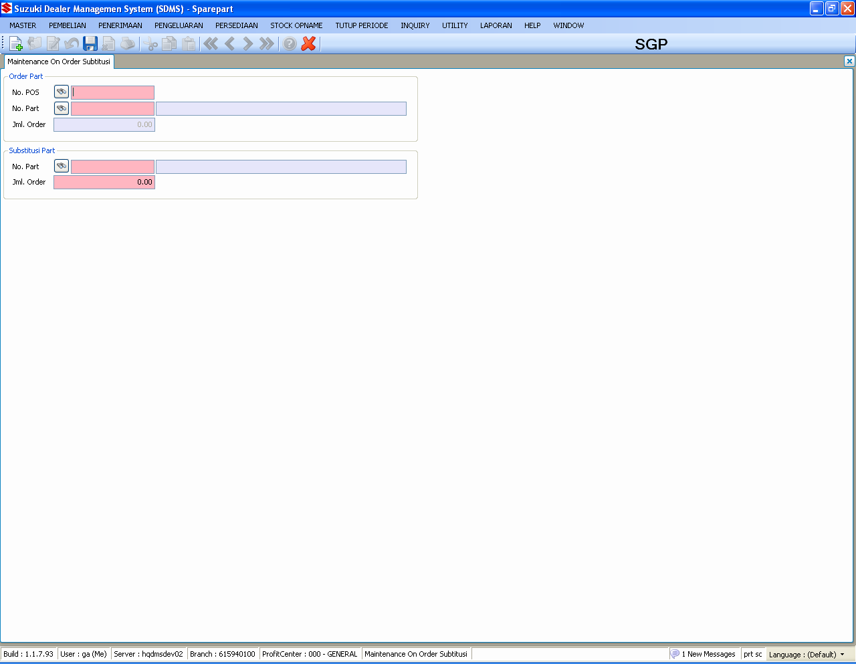
SPAREPART : PEMBELIAN
Maintain On Order Subitutusi
TABLES :
SpTrnPOrderBalance
SpTrnPPOSHdr
SpTrnPPOSDtl
SpMstItems
SpMstItemMod
Notes :
Only effected OnOrder not quantity order

Slide 22
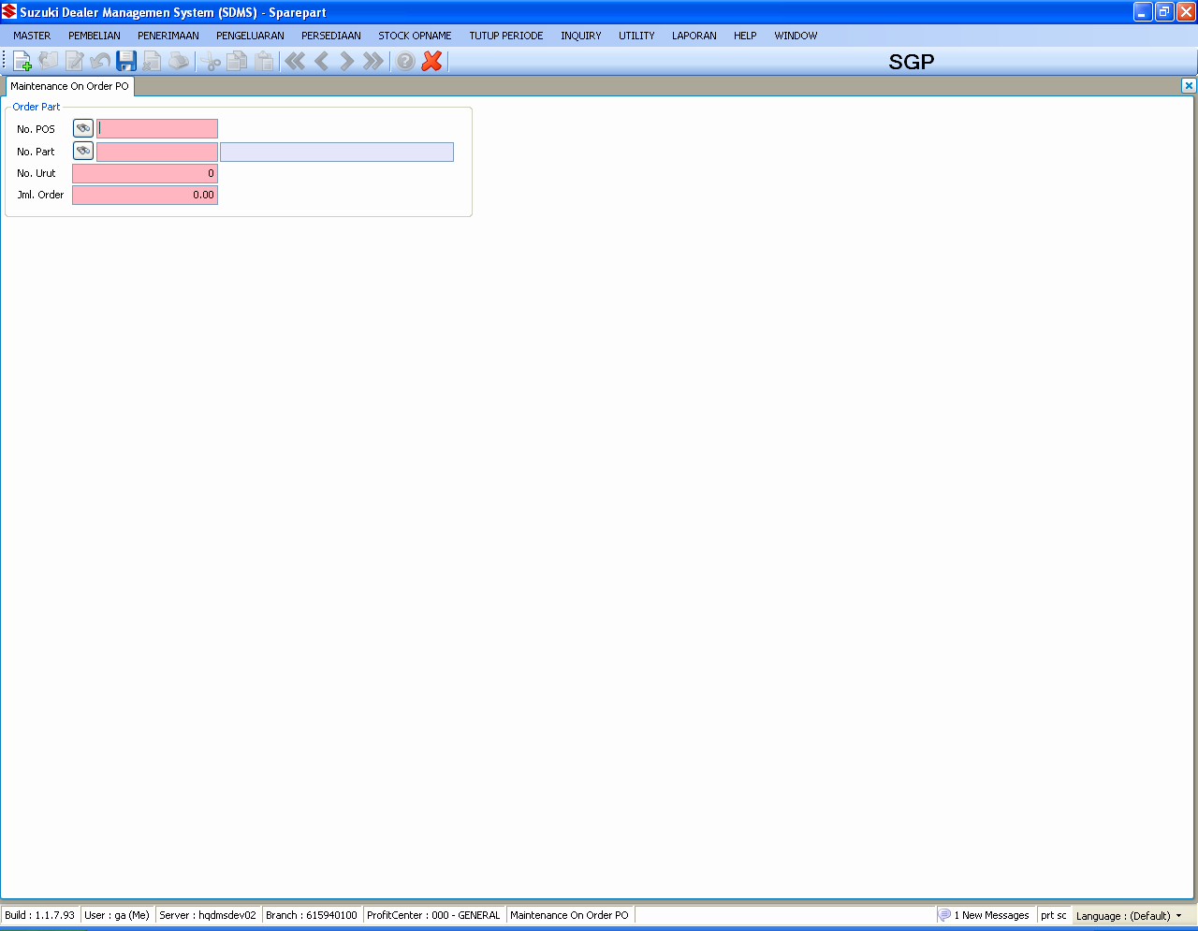
SPAREPART : PEMBELIAN
Maintain On Order
TABLES :
SpMstItems
SpTrnPOrderBalance
SpTrnPPOSHdr
SpTrnPPOSDtl
Notes :
Only effected OnOrder not quantity order

Slide 23
QUESTION
?

Slide 24
SPAREPART : PENERIMAAN
Handle the receiving process

Slide 25
SPAREPART : PENERIMAAN
PEMBELIAN
FLOWCHART
Binning List
Warehouse Receiving
HPP
Claim
NOTE :
Penerimaan divided into five main process which are :
Binning List
Warehouse Receiving
HPP Sparepart
Claim
Receiving Claim
Receiving Claim

Slide 26
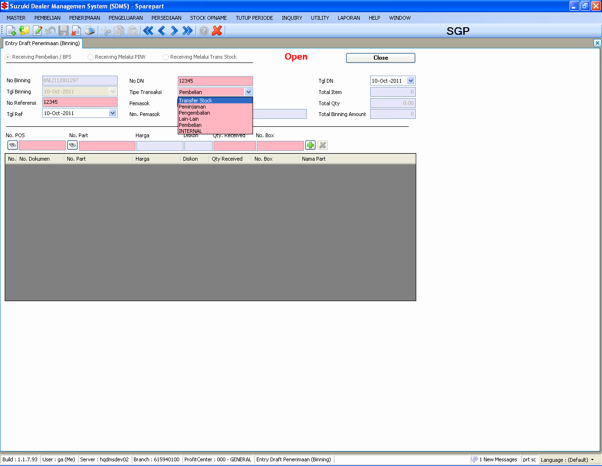
SPAREPART : PENERIMAAN
Binning List
TABLES :
SpMstItems
SpMstItemPrice
SpMstItemInfo
SpTrnPPOSHdr
SpTrnPPOSDtl
SpTrnPOrderBalance
SpTrnPBinnHdr
SpTrnPBinnDtl
SpMStItemPrice
SpUtlPINVDHdr
SpUtlPINVDDtl
SpUtlStockTrfHdr
SpUtlStockTrfDtl
GnMstDocument
Notes :
Transaction type in binning divided into six type which are :
  Pembelian
  Peminjaman
  Lain-Lain
4. Pembelian
5. Internal
6. Transfer Stock

Slide 27
SPAREPART : PENERIMAAN
Binning List – Continued
Notes :
Line : 481 ReceivingBLL
1. Updating SpMstItems by transaction type in binning list
For transaction type : Peminjaman
  Onhand and Borrow are updated
For transaction type : Pengembalian
  Onhand and Borrowed are updated
For transaction type : Pembelian and PINVS
  Onhand and InTransit are updated
For transaction : Transfer Stock, Lain-Lain and INTERNAL do not updated anythings in spMstItems
2. Using the newest cost price and purchase price
3. For transaction type : Transfer Stock and INTERNAL (No. Transfer is the document source)
4. For transaction type : Pembelian PINVS (No. DN is the document source)
The rules for receiving by PINVS
Not complete yet (Please check the outstanding)

Slide 28
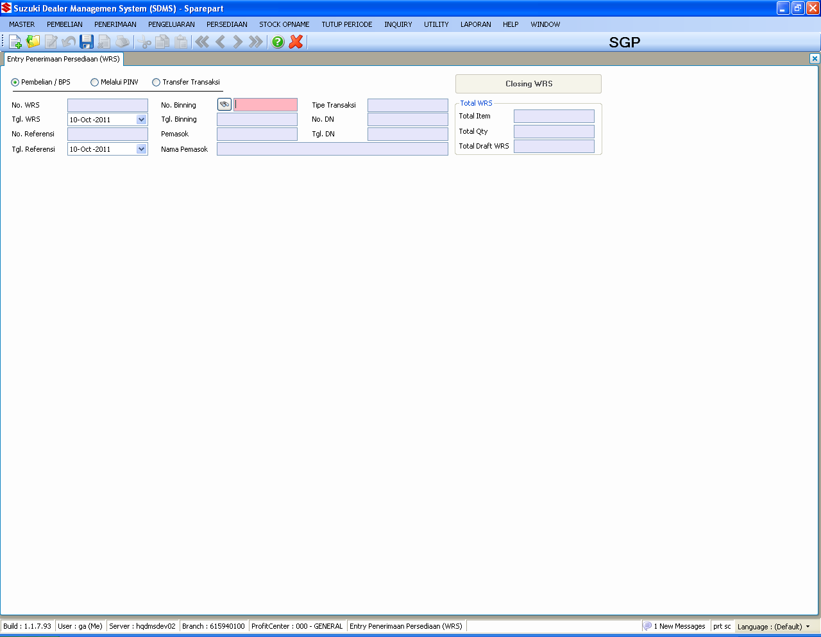
SPAREPART : PENERIMAAN
Warehouse Receiving
TABLES :
SpTrnPBinnHdr
SpTrnPBinnDtl
SpTrnPRcvHdr
SpTrnPRcvDtl
SpMstItems
SpMstItemLoc
SpMstItemPrice
SpHstItemPrice
GlInterface
GlJournal
GlJournalDtl
SpMstAccount
GnMstPeriode
GnMstSupplierClass
GnMstDocument
Notes :
Update stock are done in this process
Averaging the cost price also done in this process
Journaling process for transfer stock done in this process

Slide 29
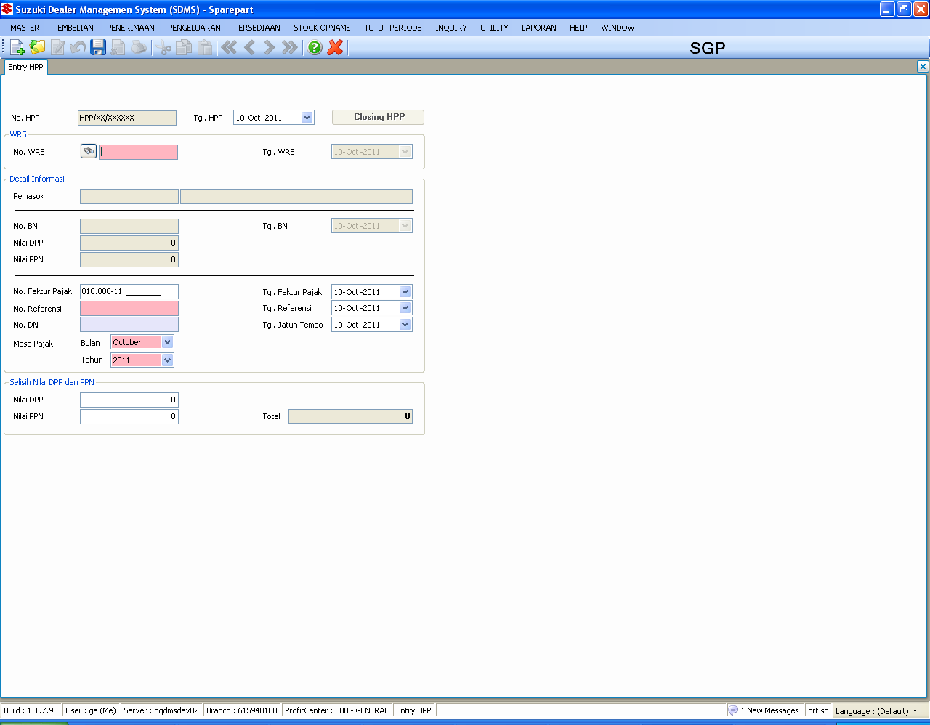
SPAREPART : PENERIMAAN
HPP Sparepart
TABLES :
SpTrnPHPP
SpTrnPRcvHdr
GlInterface
APInterface
SpMstAccount
GnMstPeriode
GnMstSupplierClass
SpMstAccount
GnMstDocument
Notes :
The differences PPN and DPP values between supplier invoice and system calculation are recorded in this process
Journaling for AP and GL Interface are done in this process

Slide 30
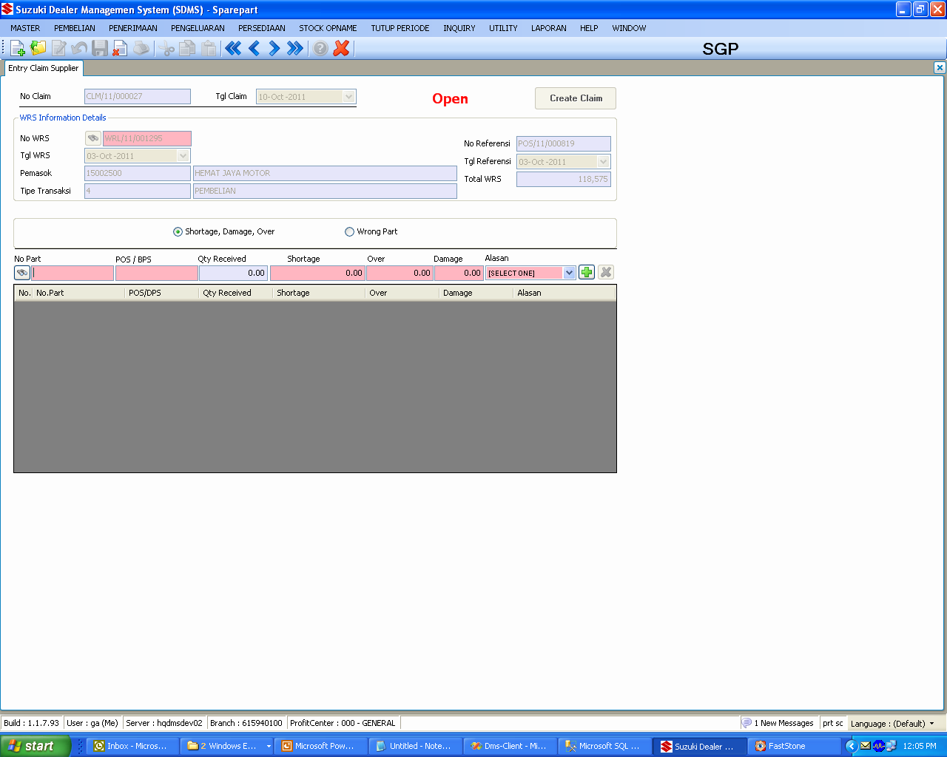
SPAREPART : PENERIMAAN
Claim
TABLES :
SpTrnPRcvHdr
SpTrnPRcvDtl
SpTrnPClaimHdr
SpTrnPClaimDtl
SpMstItems
SpMstItemLoc
GnMstDocument
Notes :
Transfer Warehouse out from 00 -> X
  X1 – Claim Damage
  X2 – Claim Shortage
  X3 – Claim Wrong

Slide 31
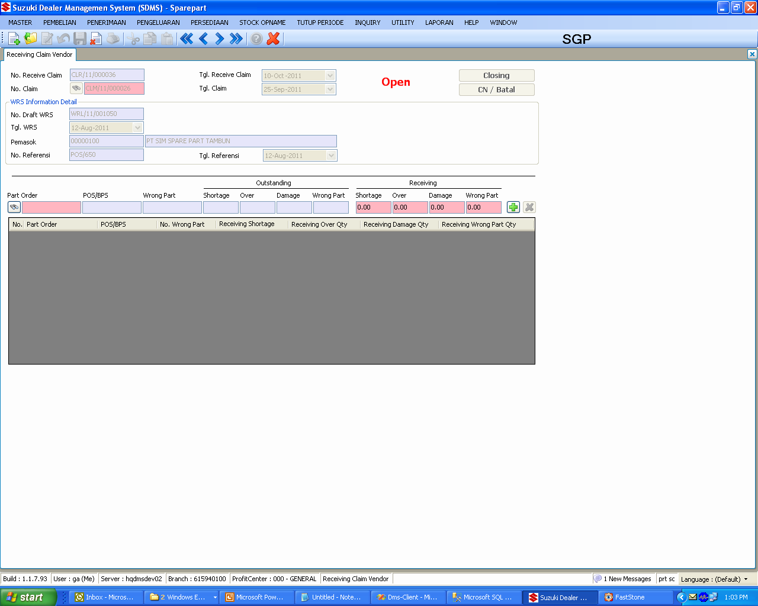
SPAREPART : PENERIMAAN
Receiving Claim
TABLES :
SpTrnPRcvHdr
SpTrnPRcvDtl
SpTrnPRcvClaimHdr
SpTrnPRcvClaimDtl
SpMstItems
SpMstItemLoc
GnMstDocument
Notes :
Transfer Warehouse out from X -> 00
  X1 – Claim Damage
  X2 – Claim Shortage
  X3 – Claim Wrong

Slide 32
QUESTION
?

Slide 33
SPAREPART : PENJUALAN
Handle the retailing process

Slide 34
SPAREPART : PENJUALAN
FLOWCHART
ENTRY DRAFT PENJ.
PEMBATALAN BO
PICKING LIST
ALL
FAKTUR PENJUALAN
LAMPIRAN NON PENJ.
PARTIAL
RETURN PENJUALAN
RETURN NON PENJ.

Slide 35
SPAREPART : PENJUALAN
FLOWCHART
LAMPIRAN SUPPLY SLIP
ENTRY DRAFT PENJ.
PICKING LIST
LAMPIRAN NON PENJ.

Slide 36
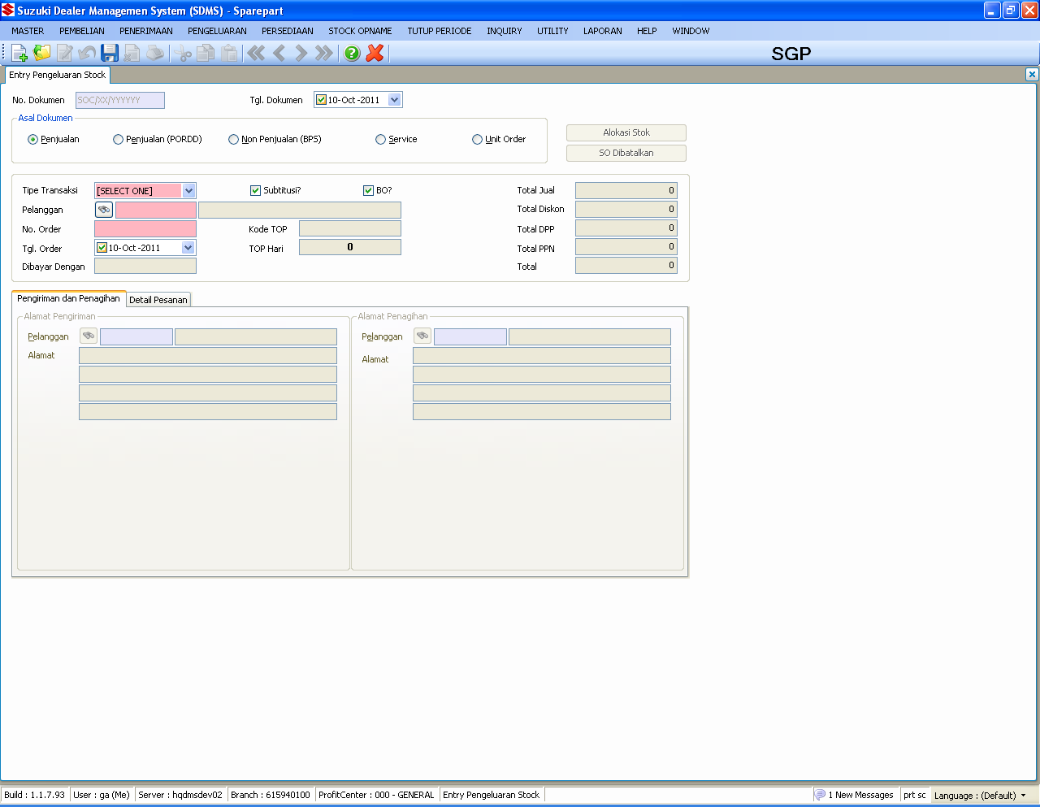
SPAREPART : PENJUALAN
Entry Draft Penjualan
TABLES :
SpTrnSORDHdr
SpTrnSORDDtl
SpTrnSOSupply
SpMstItems
SpMstItemLoc
SpMstItemMod
SpMstItemPrice
SpHstDemandCust
SpHstDemandItem
SpTrnIMovement
GnMstCustomer
GnMstCustomerProfitCenter
GnTrnBankBook
SvTrnService
SvTrnSrvItem
SpUtlPORDDHdr
SpUtlPORDDDtl
Notes :
Direct Sales/Non Sales/Service/Unit Order (Pending)
Direct Sales : Please check and re-check flag substitution and back order
No back order and substitution for BPS/Service/Unit Order

Slide 37
SPAREPART : PENJUALAN
Entry Draft Penjualan– Continued 1
Notes :
Sales Type :
0 – Sales
1 – Non sales
2 – Service
3 – Unit
Transaction Type
00 – Regular
01 – Emergency
10 – Transfer Stock
11 – Peminjaman
12 – Pengembalian
13 – Lain-lain
14 – Internal
Subtitusion and back order process included in stock allocation process
Document number for every type of transactions are different
Direct Sales/PORDS : SOC
Non Sales/BPS : BPS
Service : SSS
Unit : SSU
Substitution
SQL Server : GetModifikasi, GetElementChilds
Discount items : items, customer, campaign
Allocation updated only
Validation credit limit overdue
SpTrnSORDHdr : IsOverdueOrder line : 584
SELECT top 1 *
FROM arinterface a with(nolock, nowait)
INNER JOIN spTrnSORDHdr b with(nolock, nowait) on a.CustomerCode = b.CustomerCode
AND a.CompanyCode = b.CompanyCode
AND a.BranchCode = b.BranchCode
WHERE b.CompanyCode = @CompanyCode
AND b.BranchCode = @BranchCode
AND b.CustomerCode = @CustomerCode
AND a.ProfitCenterCode = @ProfitCenterCode
AND Convert(varchar, a.DueDate,112) <= convert(varchar,@DueDate,112)
AND NettAmt > (ReceiveAmt+CreditAmt-DebetAmt)
Validation sales < hpp
SalesTransCtl : line : 516
if (retailPrice + ppnAmt < oSORDDtl.CostPrice)
20 – External
21 – Internal
22 – FSC/KSG
23 - Warranty
30 – Unit

Slide 38
SPAREPART : PENJUALAN
Entry Draft Penjualan– Continued 2
Notes : (SERVICE : Supply Slip)
If user don’t have lampiran dokumen service access, supply slip process will be done manually by this process with sales type : Service (don’t forget to check isLinkService)
Be aware if user already proceed supply slip in this process, don’t let the user do lampiran dokumen service process
Get SPK number
SvTrnServiceBLL : Line : 2435
public static DataTable SelectSPKNo(string companyCode, string branchCode, string productType, string typeOfGoods)
Get SPK part list
SvTrnSrvItemBLL : Line : 344
public static DataTable SelectByJobOrderNo(string companyCode, string branchCode, string productType,
string typeOfGoods, string usageDocNo)
Updated svTrnSrvItem (SupplySlipNo, SupplyQty, SupplySlipDate)
SvTrnSrvItemBLL : Line :517
public static bool UpdateSupplySlipNo(IDbContext ctx, string usageDocNo, string docNo)
The rules for sales type : UNIT
Not complete yet (Please check the outstanding)

Slide 39
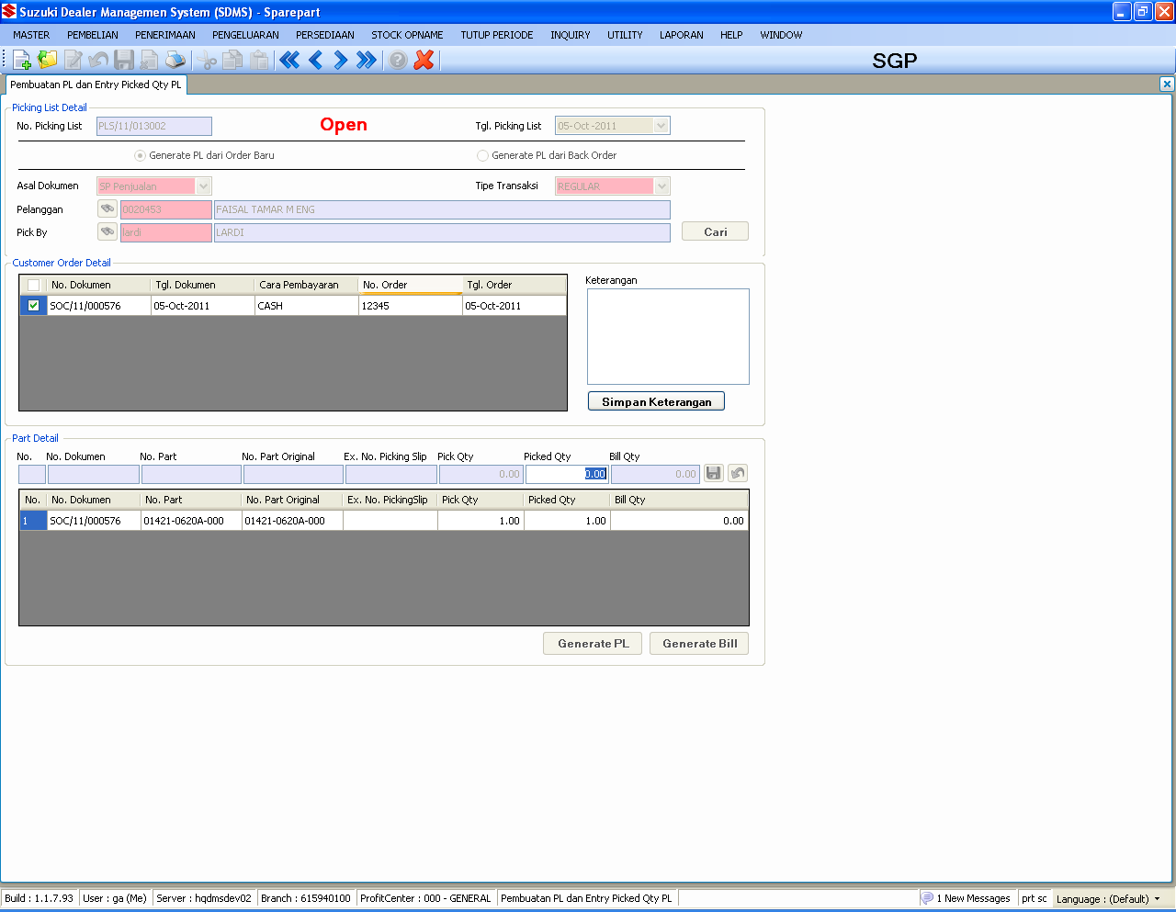
SPAREPART : PENJUALAN
Picking Slip
TABLES :
SpTrnSORDHdr
SpTrnSORDDtl
SpTrnSOSupply
SpMstItems
SpMstItemLoc
SpTrnIMovement
GnMstCustomer
GnMstCustomerProfitCenter
SpTrnSPickingHdr
SpTrnSPickingDtl
SpTrnSInvoiceHdr
SpTrnSInvoiceDtl
SpTrnSBPSFHdr
SpTrnSBPSFDtl
Notes :
Picking list can be generated from two type transaction which are
new transactions or back order transactions
Back Order can occurred in this process, effected the part’s allocation

Slide 40
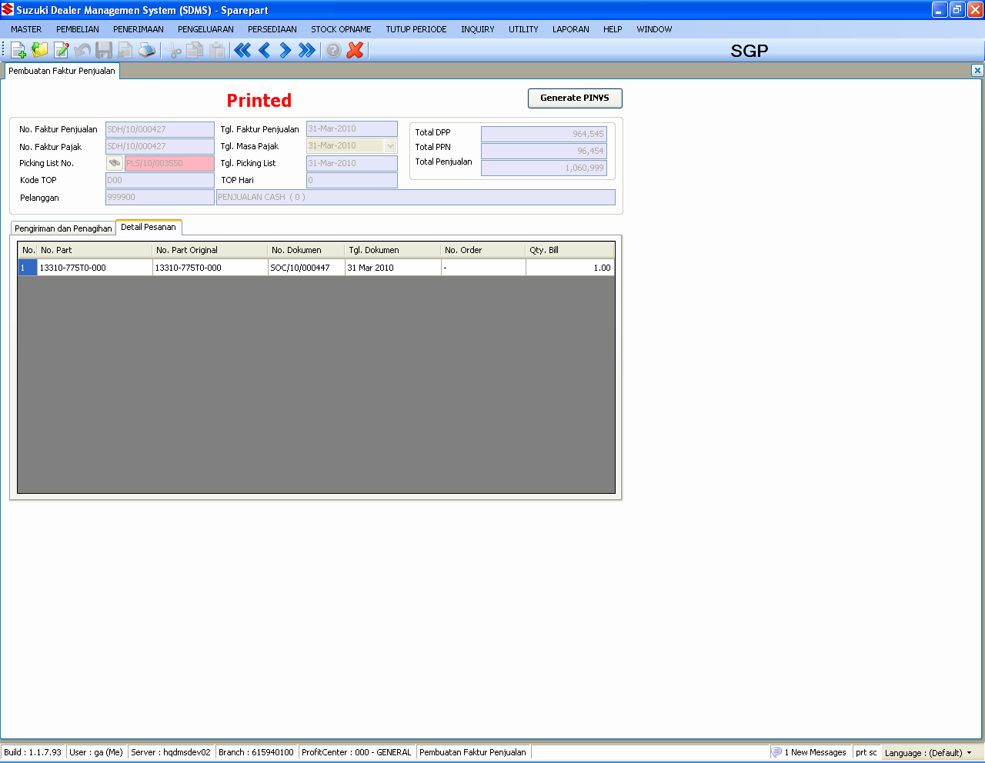
SPAREPART : PENJUALAN
FAKTUR PENJUALAN
TABLES :
SpTrnSPickingHdr
SpTrnSPickingDtl
SpMstItems
SpMstItemLoc
SpHstDemandCust
SpHstDemandItem
SpTrnIMovement
GnMstCustomer
GnMstCustomerClass
GnMstCustomerProfitCenter
SpTrnSFpjHdr
SpTrnSFpjDtl
SpTrnSFpjInfo
GlInterface
ArInterface
SpMstAccount
SpTrnSInvoiceHdr
SpTrnSinvoiceDtl
Notes :
Journaling for AR and GL Interface are done in this process
Updated stock master item and master item location (onhand, allocation)
Check isPKP customer for identify it is faktur sederhana (SDH)
or faktur pajak (FPJ)
Bill Address can be changed if it a faktur sederhana

Slide 41
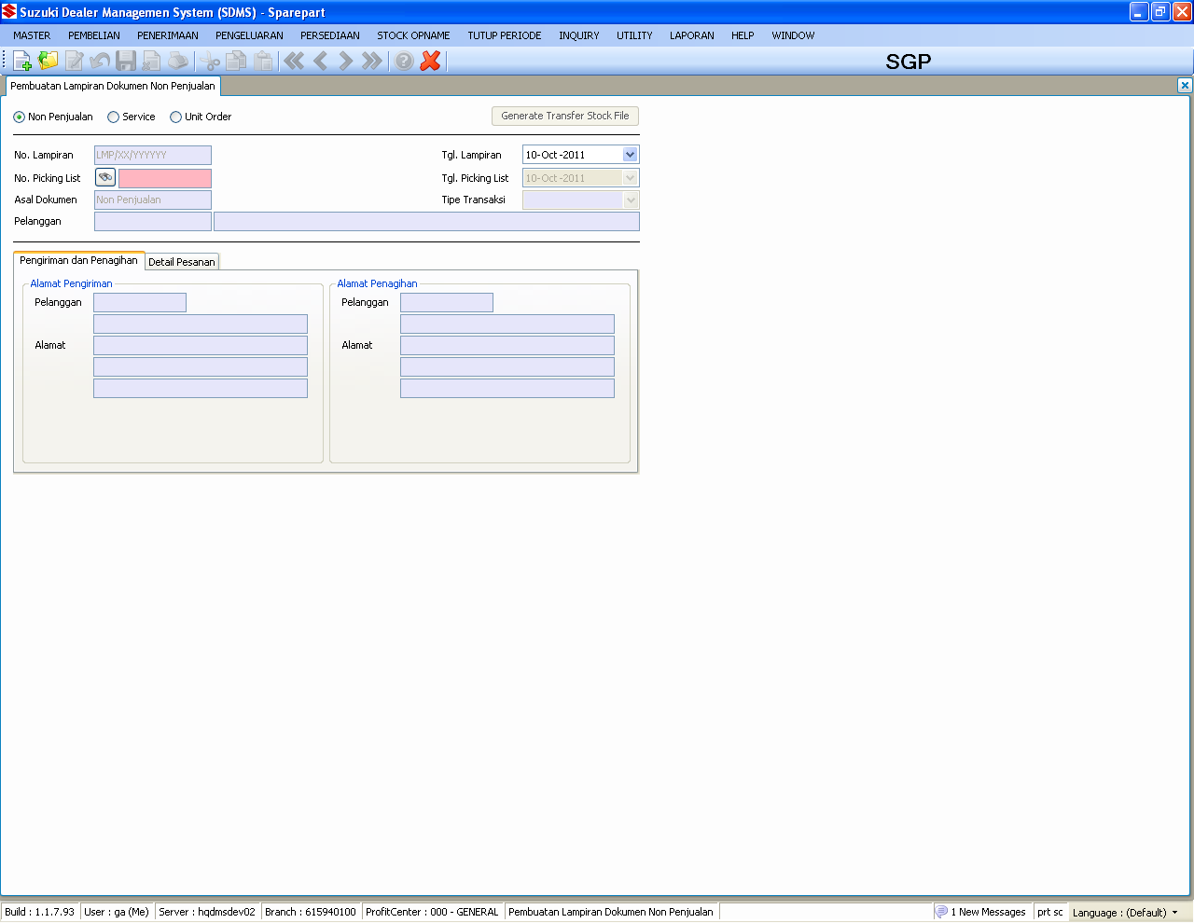
SPAREPART : PENJUALAN
LAMPIRAN NON PENJUALAN
TABLES :
SpTrnSPickingHdr
SpTrnSPickingDtl
SpMstItems
SpMstItemLoc
SpMstItemPrice
SpHstDemandCust
SpHstDemandItem
SpTrnIMovement
GnMstCustomer
GnMstCustomerClass
GnMstCustomerProfitCenter
SpTrnSLmpHdr
SpTrnSLmpDtl
GlInterface
SpMstAccount
GlJournal
GlJournalDtl
SpUtlStockTrfHdr
SpUtlStockTrfDtl
SpTrnSBPSFHdr
SpTrnSBPSFDtl
Notes :
1. Journaling for transfer stock(10) and internal(14)

Slide 42
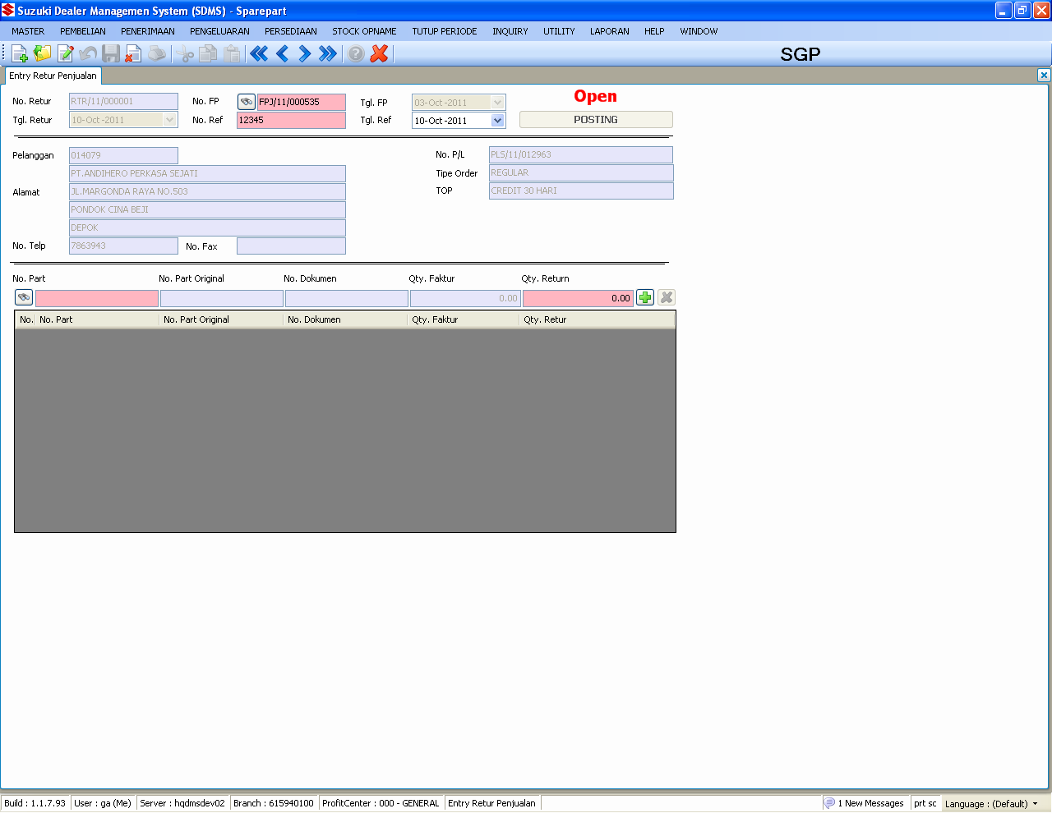
SPAREPART : PENJUALAN
RETURN PENJUALAN
TABLES :
SpTrnSFpjHdr
SpTrnSFpjDtl
GnMstCustomer
SpMstItems
SpMstItemLoc
SpTrnSRturHdr
SpTrnSRturDtl
SpTrnIMovement
GlInterface
SpMstAccount
Notes :
1. Journaling for GL Interface (Inventory/COGS) are done in this process

Slide 43
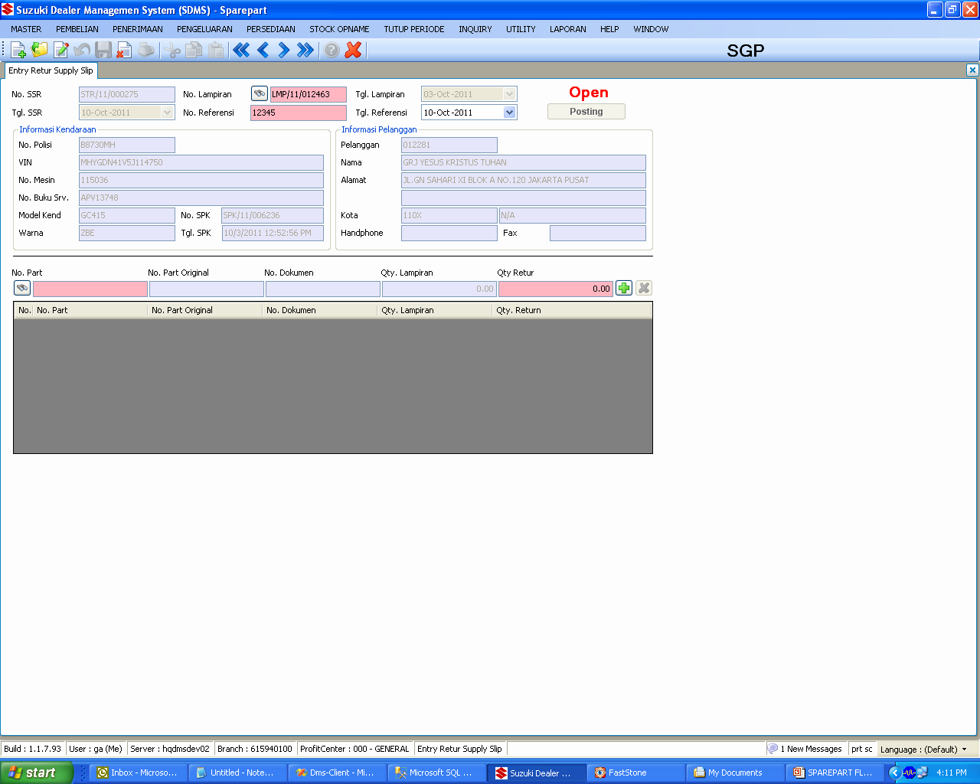
SPAREPART : PENJUALAN
RETURN NON PENJUALAN
TABLES :
SpTrnSLmpHdr
SpTrnSLmpDtl
GnMstCustomer
SpMstItems
SpMstItemLoc
SpTrnSRturSSHdr
SpTrnSRturSSDtl
SpTrnIMovement
SvTrnService
SvTrnSrvItem
Notes :
Updated svTrnSrvItem (SSReturnNo, SSReturnDate, ReturnQty)
SvTrnSrvItemBLL : Line : 872
public static bool UpdateReturnQty(IDbContext ctx, string returnNo)

Slide 44
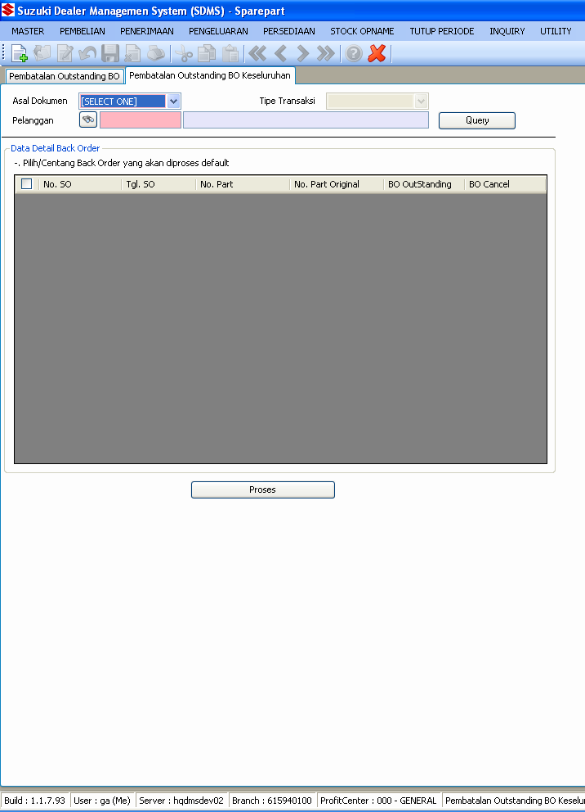
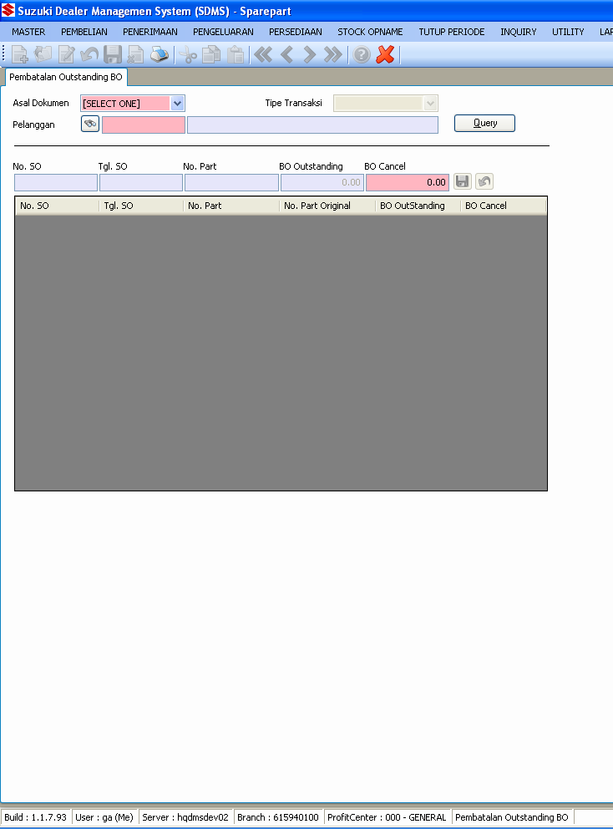
SPAREPART : PENJUALAN
PEMBATALAN BACK ORDER
TABLES :
SpMstItems
SpMstItemLoc
SpTrnSORDDtl
SpTrnSOSupply
SpTrnSORDHdr
GnMstCustomer
Notes :
Both have same process
with different scope

Slide 45
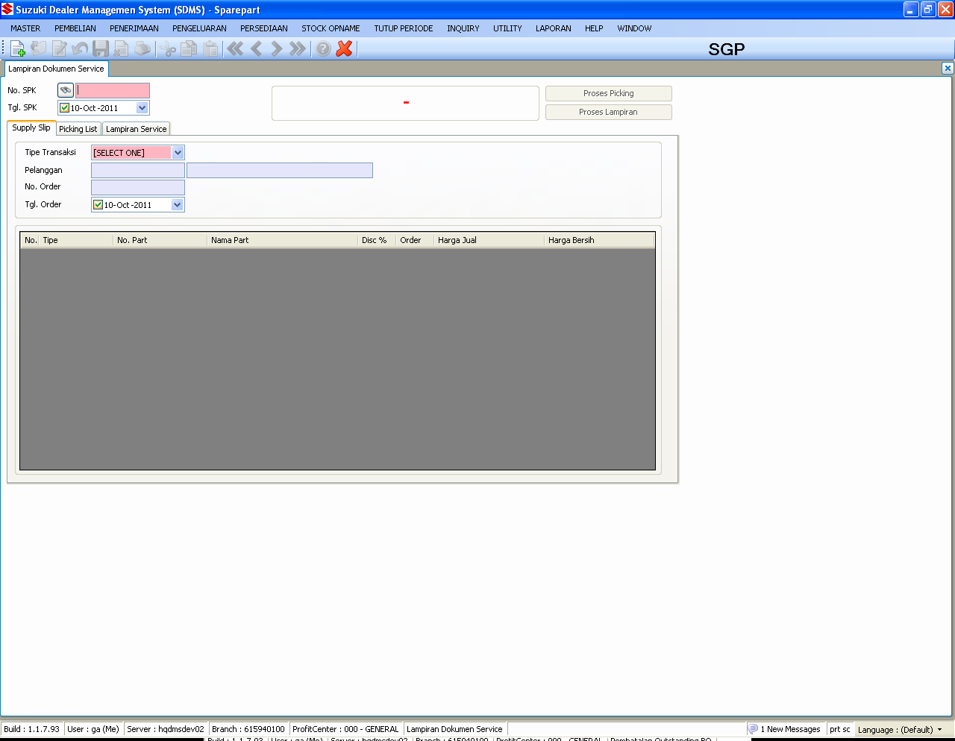
SPAREPART : PENJUALAN (Enhc.)
LAMPIRAN SUPPLY SLIP
TABLES :
SpTrnSORDHdr
SpTrnSORDDtl
SpTrnSOSupply
SpHstDemandCust
SpHstDemandItem
SpTrnIMovement
SpTrnSPickingHdr
SpTrnSPickingDtl
SpTrnSBPSFHdr
SpTrnSBPSFDtl
SpTrnSLmpHdr
SpTrnSLmpDtl
SpMstItems
SpMstItemLoc
SvTrnService
SvTrnSrvItem
Functions :
uspfn_GenerateSSPickingslip
uspfn_GenerateBPSLampiran
Notes :
Supply slip will recorded to the service module in proses picking
This process doesn’t create a journal
Available quantity will be check in proses picking
Stock (onhand) will be reduced when proses lampiran
Printing available in this screen with some limitation condition (not closed yet)

Slide 46
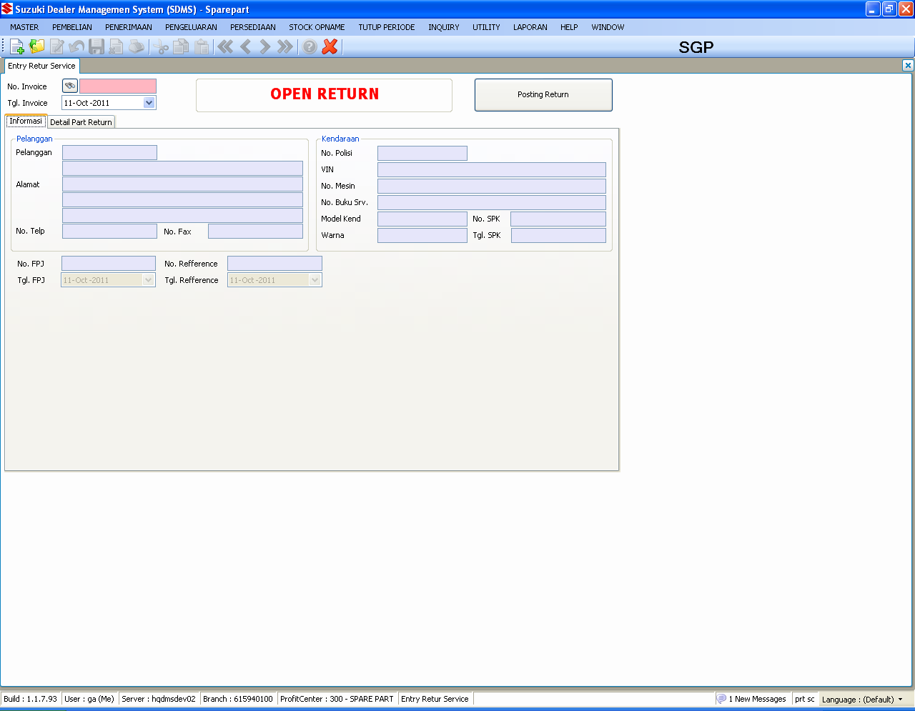
SPAREPART : PENJUALAN (Enhc.)
RETURN SERVICE
TABLES :
SvTrnInvoice
SvTrnInvItem
SpTrnSRturSrvHdr
SpTrnSRturSrvDtl
SpMstItems
SpMstItemLoc
SpTrnIMovement
SpMstItemPrice
Notes :
Function :
uspfn_GenerateReturnService

Slide 47
QUESTION
?

Slide 48
SPAREPART : INVENTORY
Handle the inventory process such as stock adjustment , transfer warehouse and reserved

Slide 49
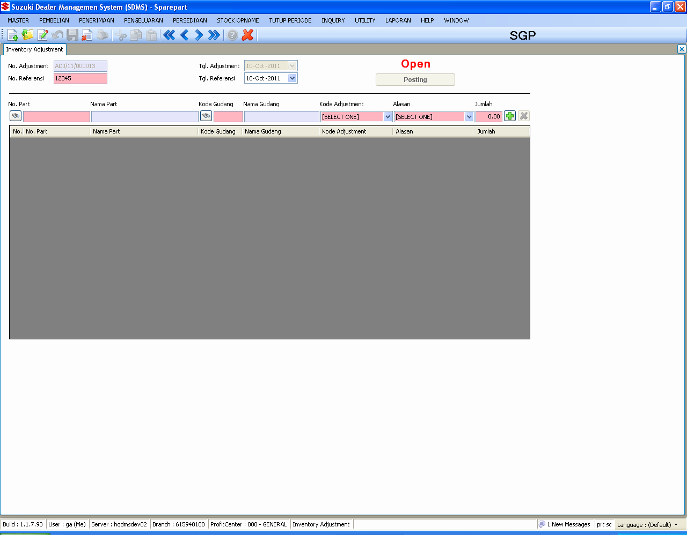
SPAREPART : INVENTORY
ADJUSTMENT
TABLES :
SpMstItems
SpMstItemLoc
SpTrnIAdjustHdr
SpTrnIAdjustDtl
SpTrnIMovement
SpMstAccount
GlInterface
GnMstDocument
Notes :
Adjustment code : + or – based on the condition needed
Warehouse code <= 96 : update master item and master item location
Warehouse code > 96 : update master item location only
Journal : Inventory/COGS based on the type of goods

Slide 50
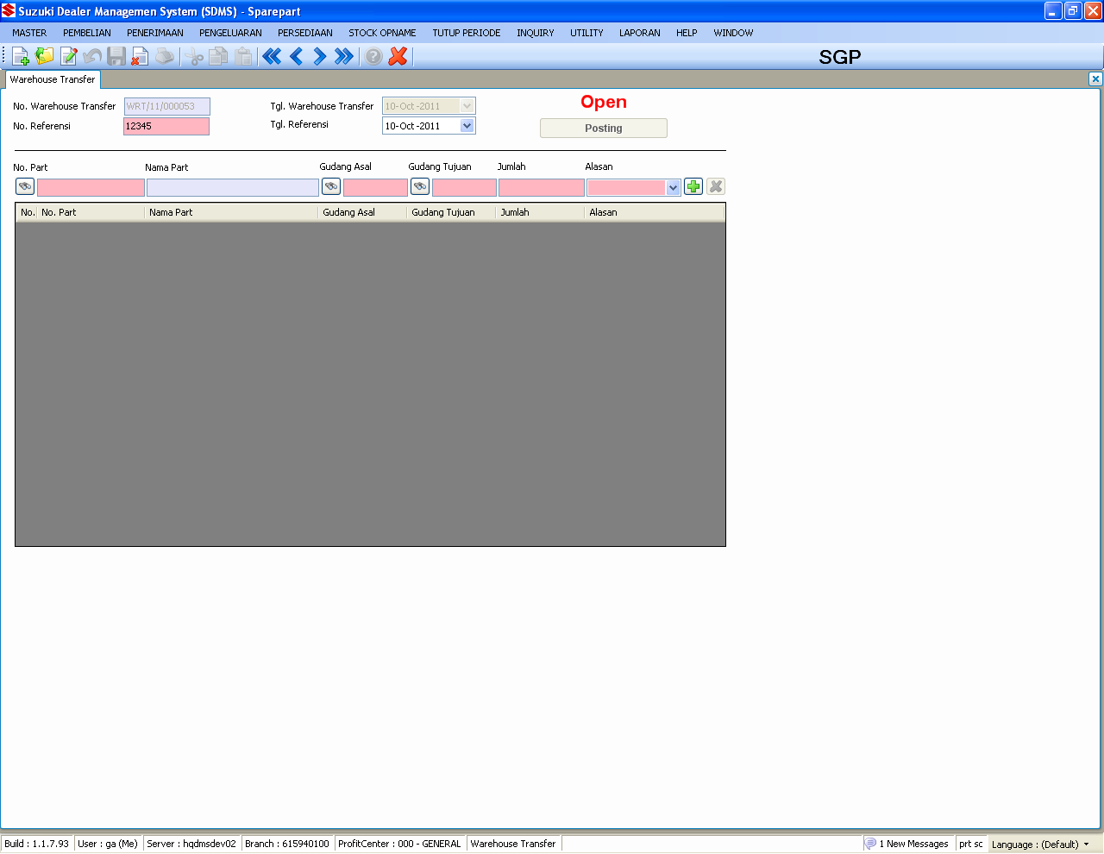
SPAREPART : INVENTORY
WAREHOUSE TRANSFER
TABLES :
SpMstItems
SpMstItemLoc
SpTrnIMovement
SpTrnIWhTrfHdr
SpTrnIWhTrfDtl
GnMstDocument
Notes :
Transfer from 00-96 to > 96 : subtract master items and master items location (from) on hand
Transfer from 00-96 to 00-96 : subtract master items location (from) on hand
Transfer from 96 to 00-96 : add master items and master items location (to) on hand
2. It’s the basic process of spare part’s claim

Slide 51
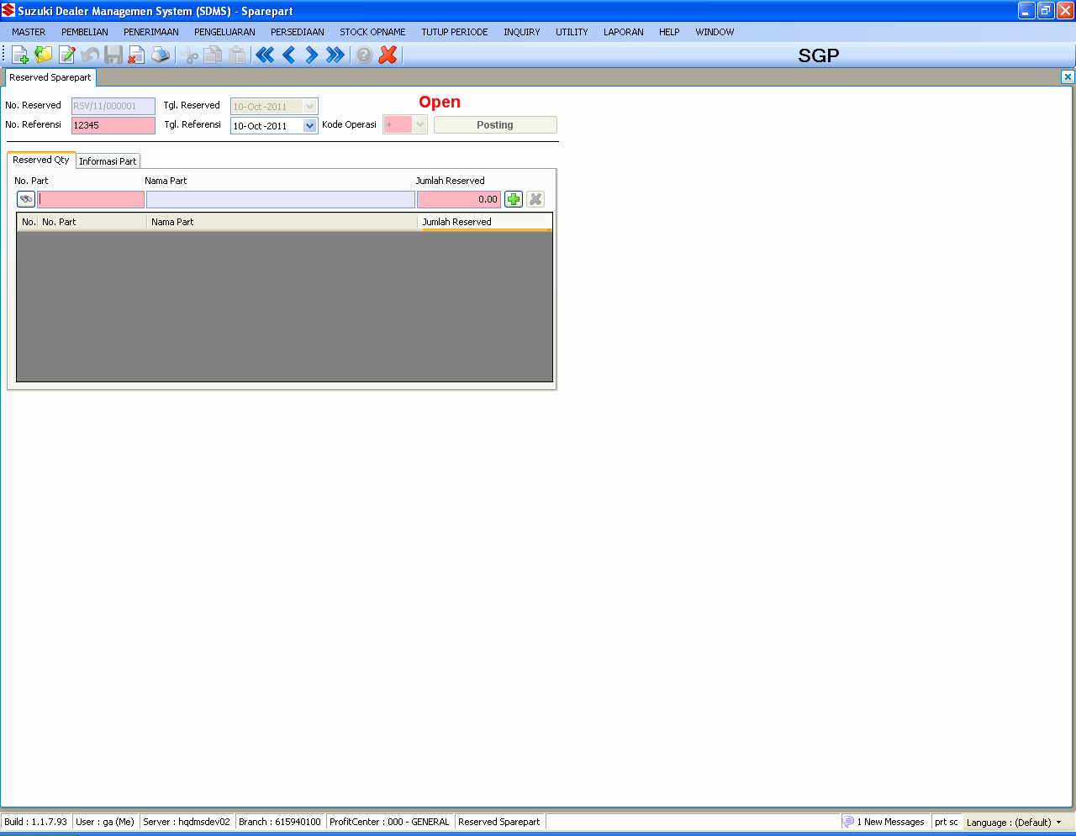
SPAREPART : INVENTORY
RESERVED
TABLES :
SpMstItems
SpMstItemLoc
SpTrnIReservedHdr
SpTrnIReservedDtl
Notes :
Reserved process only can handle reserved main stock warehouse (00)

Slide 52
QUESTION
?

Slide 53
SPAREPART : POSTING
Handle the closing month process

Slide 54
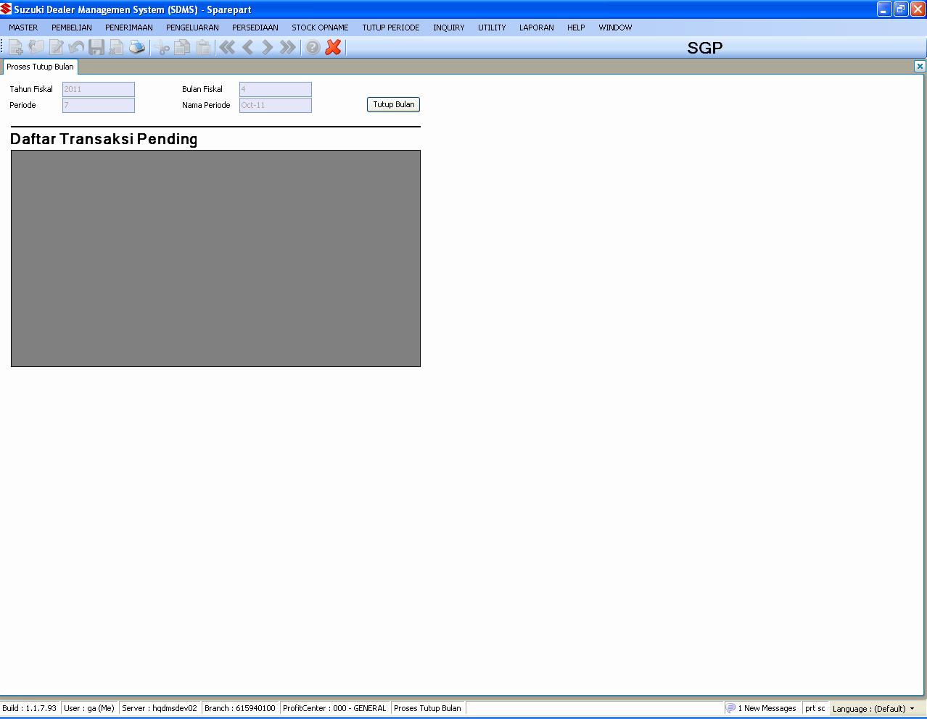
SPAREPART : POSTING
TUTUP BULAN
TABLES :
SpMstItems
SpMstItemLoc
SpMstItemMod
SpMstItemPrice
SpTrnSORDHdr
SpTrnSORDDtl
SpHstItemStatus
SpHstDemandItem
SpHstStockMovement
SpTrnPRcvHdr
SpTrnPRcvDtl
SpTrnSFpjHdr
SpTrnSFpjDtl
SpTrnSLmpHdr
SpTrnSLmpDtl
SpTrnIAdjustHdr
SpTrnIAdjustDtl
SpTrnIWhtrfHdr
SpTrnIWhtrfDtl
SpTrnSRturHdr
SpTrnSRturDtl
SpTrnSRturSSHdr
SpTrnSRturSSDtl
SpMstOrderParam
GnMstCoProfileSpare

Slide 55
SPAREPART : POSTING
TUTUP BULAN – Continued 1
Notes :
PostingBLL
Process closing months are divided into eleven sections which are
Update BO Register
public static bool UpdateBORegisterTuning(IDbContext ctx, SysUser user)
Insert Item Status
public static bool InsertHistoryItemStatusTuning(IDbContext ctx, SysUser user, int year, int month)
Update Demand Average
public static bool UpdateDemandAverageTuning(IDbContext ctx, SysUser user, int year, int month)
Update ABC Class
public static bool UpdateABCClassTuning(IDbContext ctx, SysUser user, int year, int month)
Update Moving Code
public static bool UpdateMovingCodeTuningV2(IDbContext ctx, int year, int month, SysUser user)
Insert History Movement
public static bool InsertHistoryMovementTuning(IDbContext ctx, SysUser user, int year, int month)
Update BOM
public static bool UpdateBOMTuning(IDbContext ctx, SysUser user)
Update Order Point
public static bool UpdateOrderPointTuning(IDbContext ctx, SysUser user)
Insert Transaction History
public static bool InsertTransactionHistoryTuning(IDbContext ctx, SysUser user, int year, int month)
Update Demand History
public static bool UpdateDemandHistoryTuning(IDbContext ctx, SysUser user, int year, int month)
Update Transaction Period
public static bool UpdateTransactPeriod(IDbContext ctx, GnMstCoProfileSpare oCoProfileSpare, SysUser user)

Slide 56
QUESTION
?

Slide 57
SPAREPART : STOCK OPNAME
Handle the stock opname process

Slide 58
SPAREPART : STOCK OPNAME
FLOWCHART
PROSES INVENTORY TAG/FORM
ENTRY INVENTORY TAG/FORM
BLANK TAG/FORM
CREATE
CETAK ANALISA
DELETE
POSTING DATA STOCK TAKING TO MASTER

Slide 59
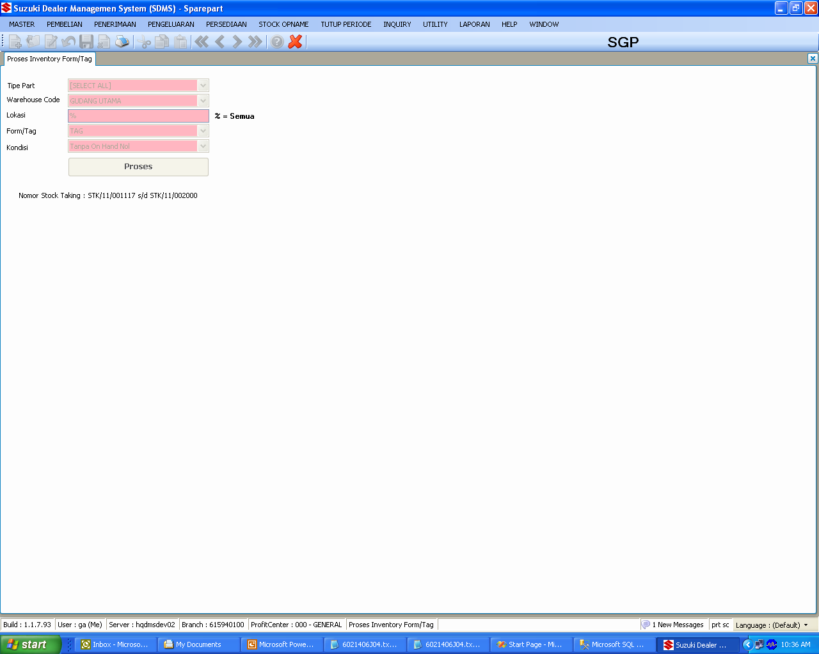
SPAREPART : STOCK OPNAME
PROCESS INVENTORY FORM/TAG
TABLES :
SpMstItems
SpMstItemLoc
SpTrnStockTakingHdr
SpTrnStockTakingTemp
Notes :
Initial Stock Op name process
Validation checking onOrder, InTransit, Allocation, Reserved
ProcessInventoryTagFormCtl : line : 336
private bool ValidationProsesInvTag()
Please be sure to check the condition and the type (Form/Tag) before enter stock op name process
Form -> 1 stock op name number consist 25 part
Tag -> 1 stock op name number consist 1 part

Slide 60
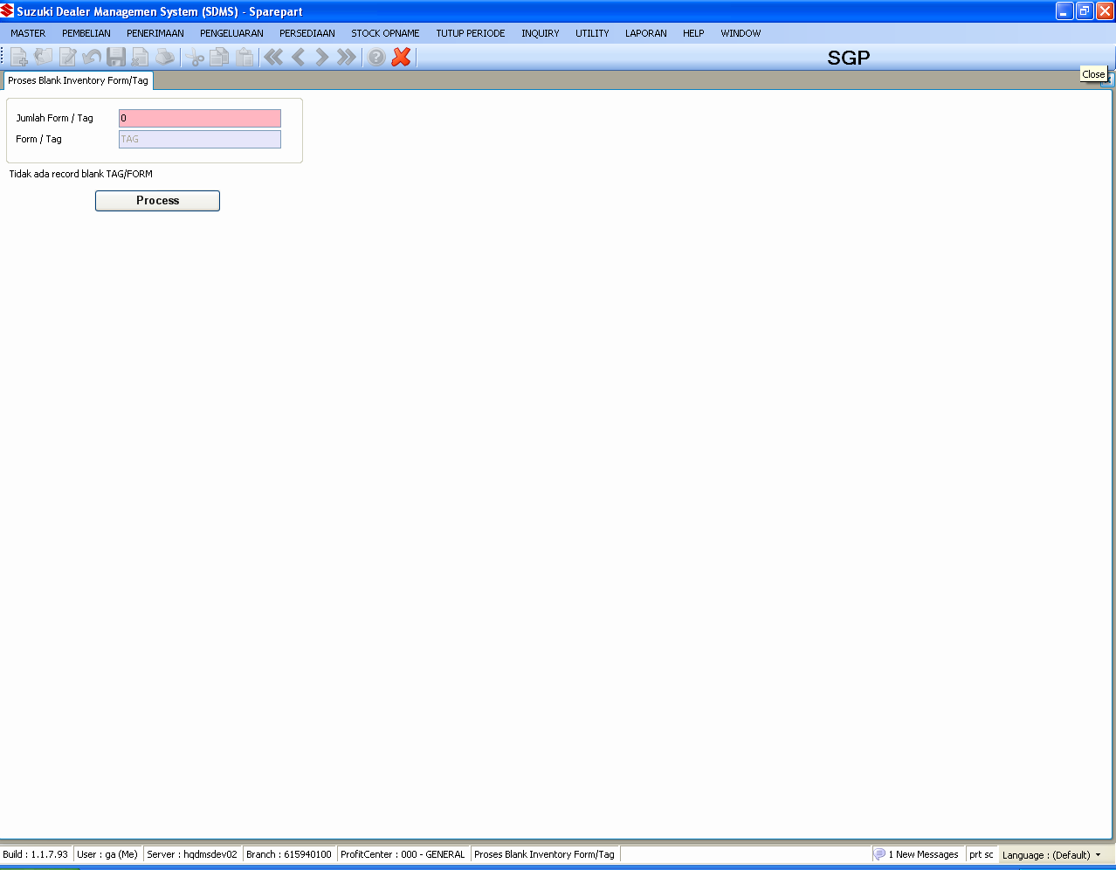
SPAREPART : STOCK OPNAME
PROSES BLANK INVENTORY FORM/TAG
TABLES :
SpTrnStockTakingTemp
Notes :
Blank Tag/Form purposes :
a. If there is any part which not registered in stock op name list
b. If there is part registered in stock op name list which have un-registered location
StockTakingBLL : Line : 215
public static bool ProsesInvBlankTag(SysUser user, decimal qtyTag, string codeType)

Slide 61
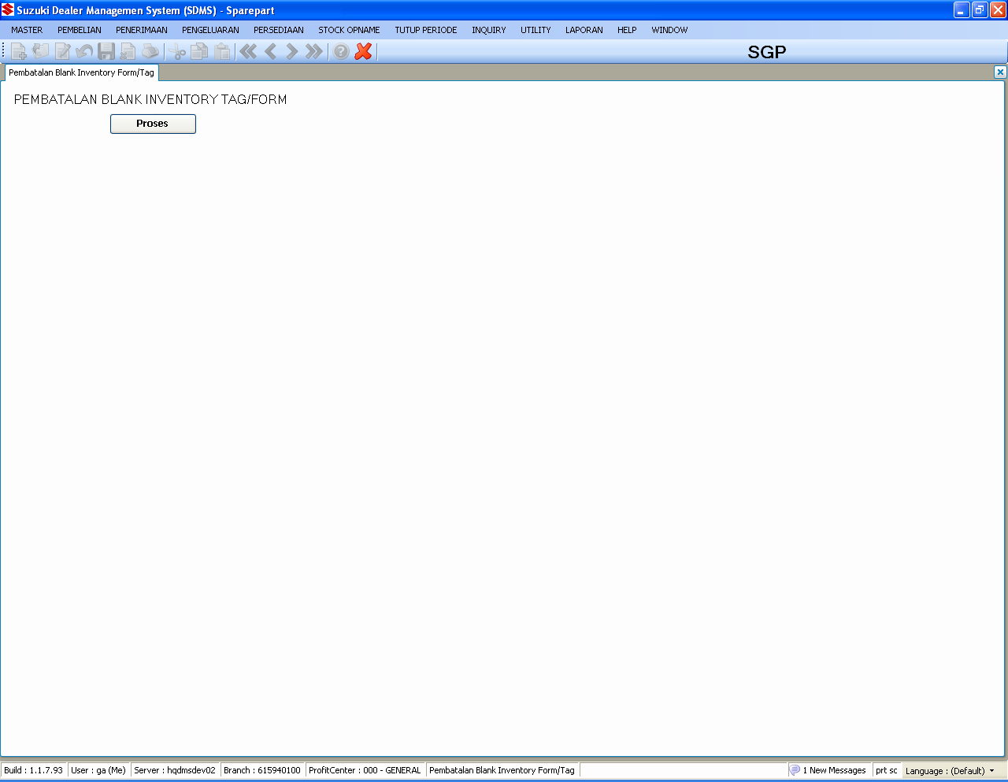
SPAREPART : STOCK OPNAME
PEMBATALAN BLANK INVENTORY FORM/TAG
TABLES :
SpTrnStockTakingTemp
SpTrnStockTakingDtl
Notes :
Button Proses will activated if there is any blank tag/form exists

Slide 62
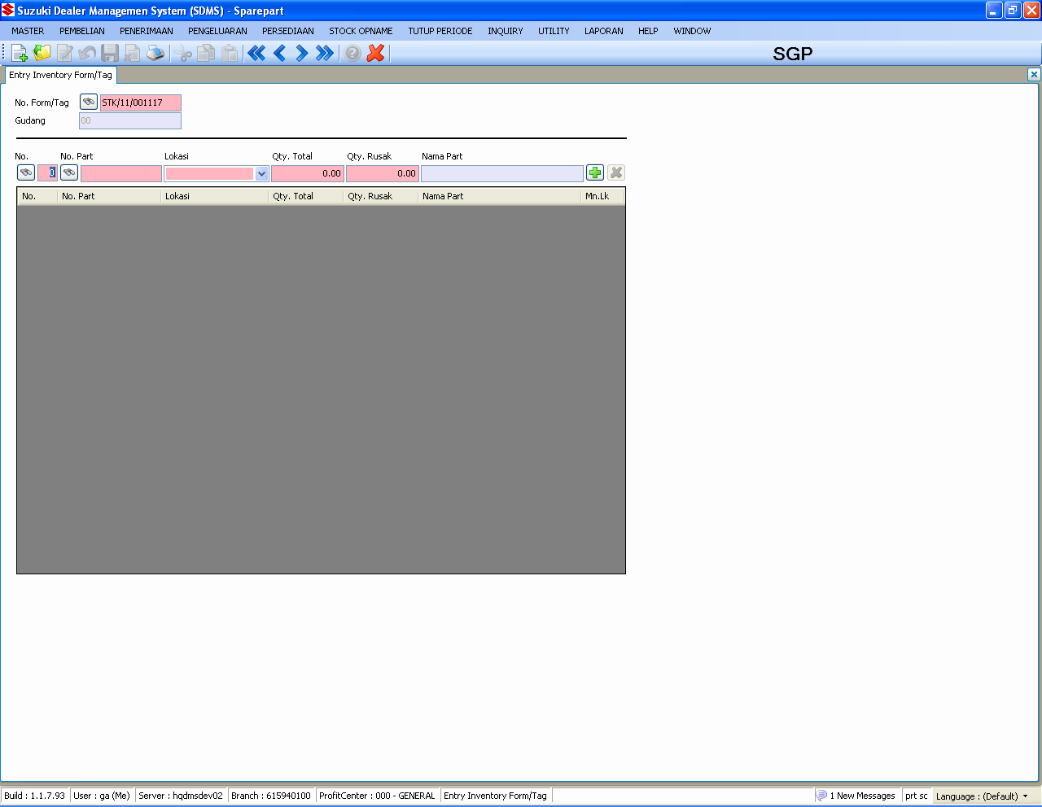
SPAREPART : STOCK OPNAME
ENTRY INVENTORY FORM/TAG
TABLES :
SpTrnStockTakingTemp
SpTrnStockTakingDtl
Notes :
Entry the result of stock op name
Qty Total = Qty Total (Damage included)

Slide 63
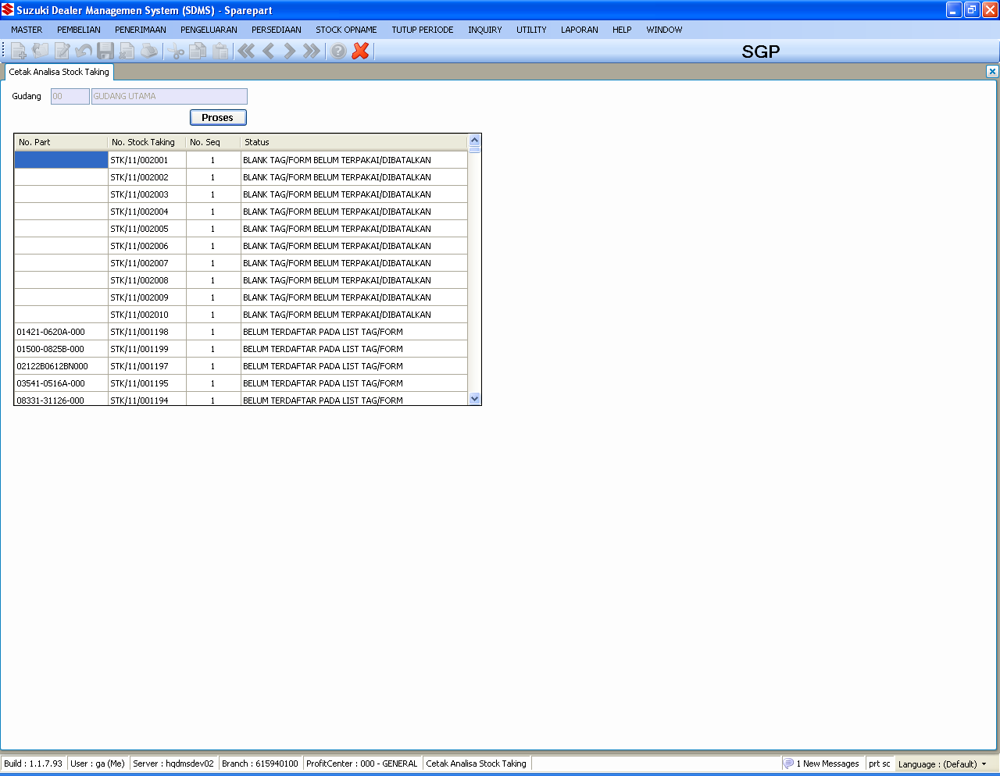
SPAREPART : STOCK OPNAME
CETAK ANALISA STOCK TAKING
TABLES :
SpTrnStockTakingTemp
SpTrnStockTakingDtl
Notes :
Validation before posting stock taking
SpTrnStockTakingDtlBLL : Line : 983
public static int StockTakingAnalyzeDtl(IDbContext ctx, SysUser user, SpTrnStockTakingHdr recordHeader, PostingProgress pb)
a. Check maximum seven location for one part
b. Check if there is any blank tag/form that have been not canceled yet
c. Check main location exist for every part in the stock op name list

Slide 64
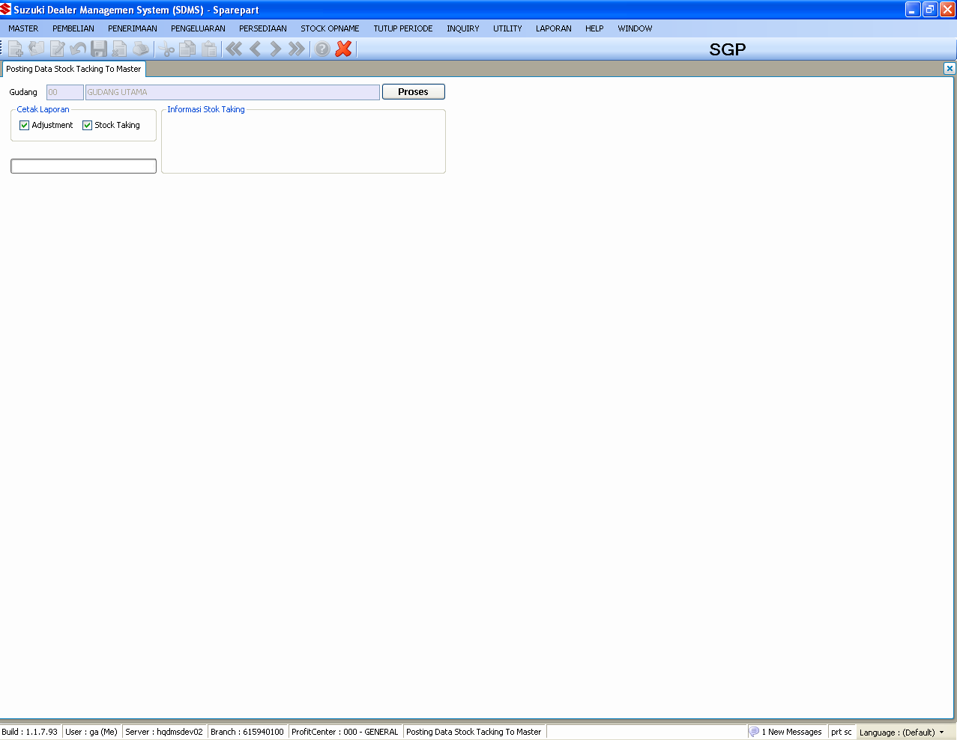
SPAREPART : STOCK OPNAME
POSTING DATA STOCK TAKING TO MASTER
TABLES :
SpTrnStockTakingTemp
SpTrnStockTakingDtl
SpTrnStockTakingHdr
SpMstItems
SpMstItemLoc
SpTrnIMovement
SpTrnIAdjustHdr
SpTrnIAdjustDtl
SpTrnIWhTrfHdr
SpTrnIWhTrfDtl
Notes :
Process that will be occurred within this process :
Inventory Adjustment
Warehouse Transfer
please check out the detail process of these two inventory process control

Slide 65
QUESTION
?

Slide 66
SPAREPART : UTILITY
Handle other process related to SDMS spare part daily operations

Slide 67
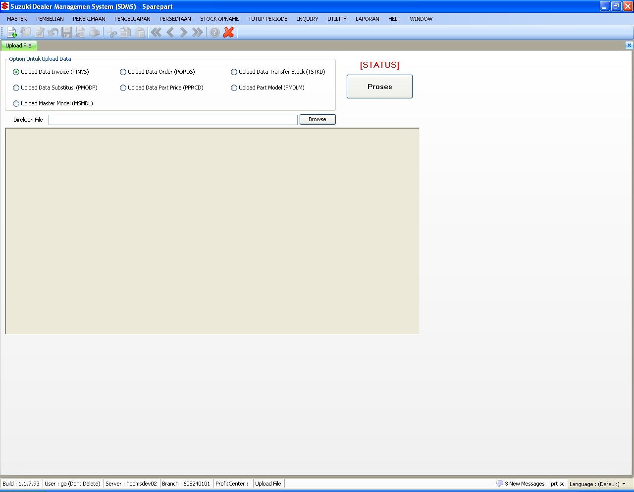
SPAREPART : UTILITY
UPLOAD FILE (MANUAL)

Slide 68
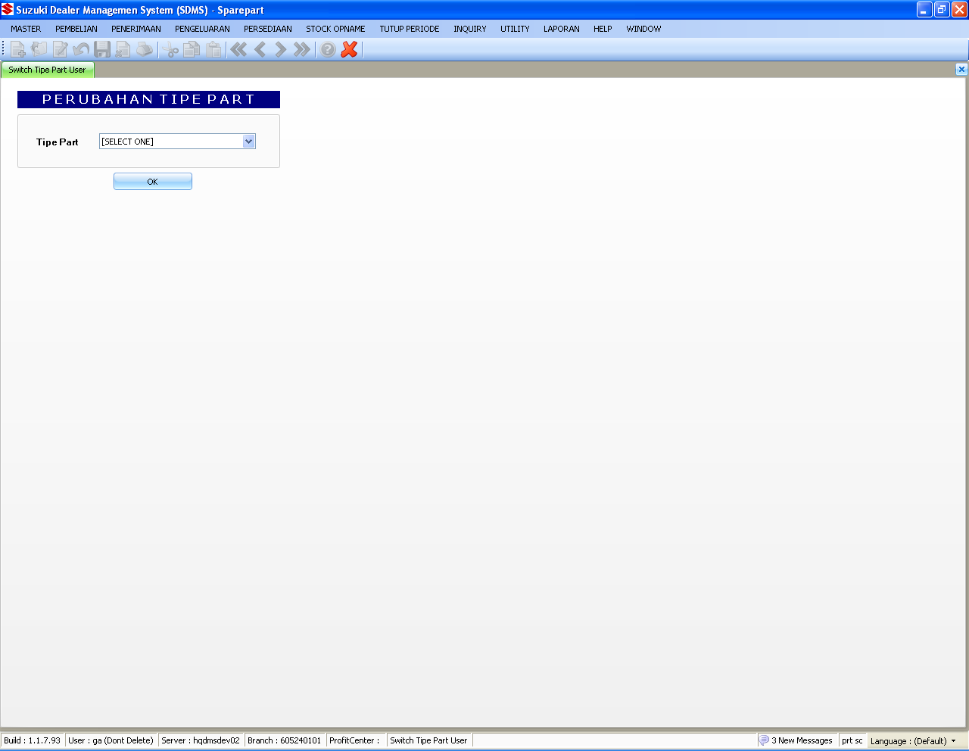
SPAREPART : UTILITY
SWITCH TIPE PART USER

Slide 69
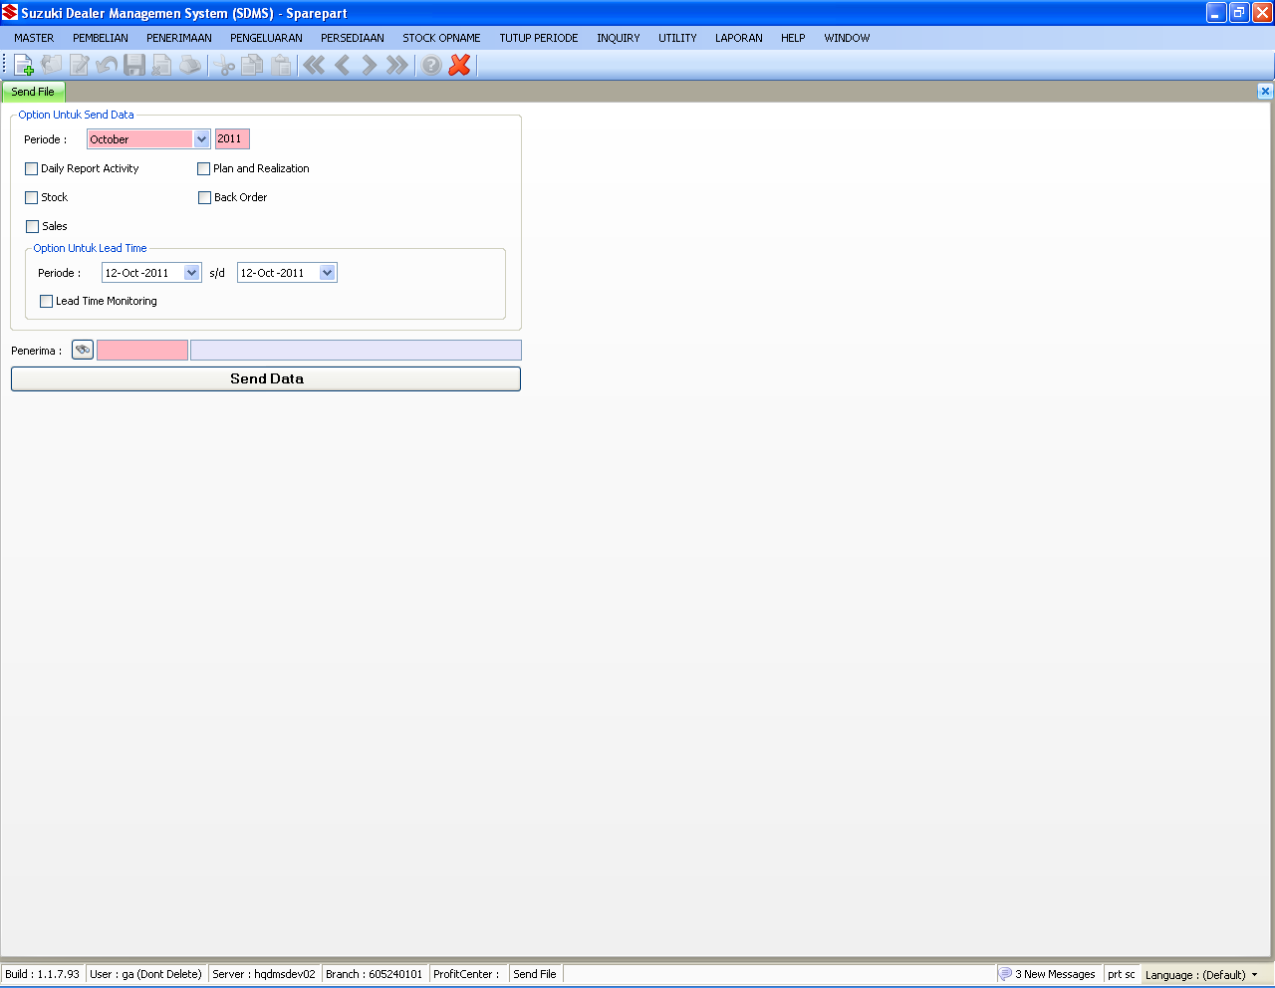
SPAREPART : UTILITY
SEND FILE (UN-USED)

Slide 70
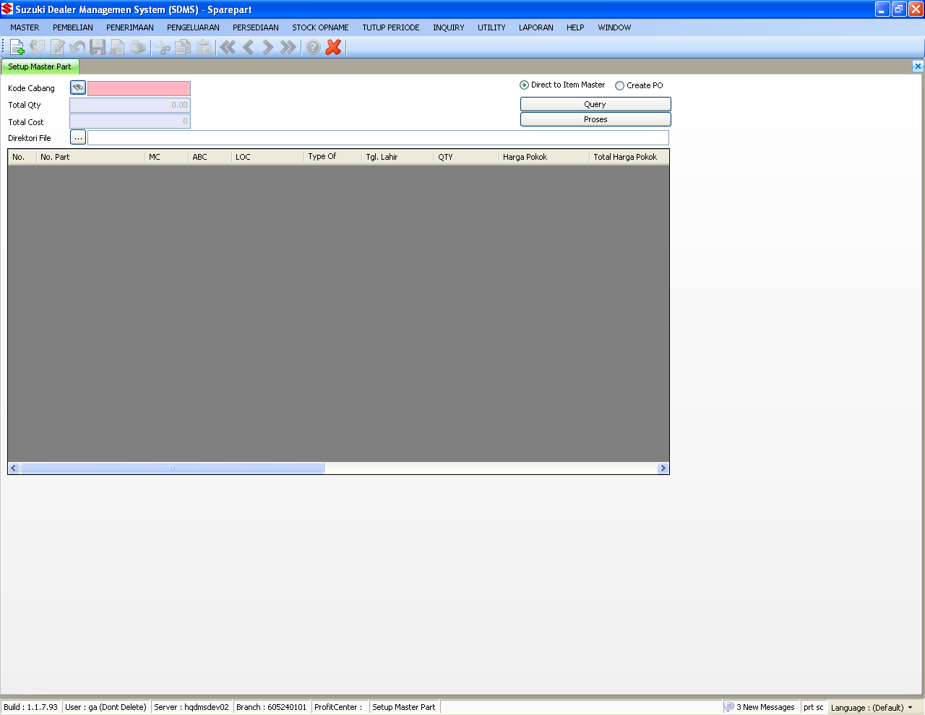
SPAREPART : UTILITY
SETUP MASTER PART

Slide 71
SPAREPART : UTILITY
SETUP MASTER PART – Continued 1
Notes :
Two method for uploading initial stock for spare part
a. directly insert to master item
b. create initial purchase order number
The excel template can be directly found in

Slide 72
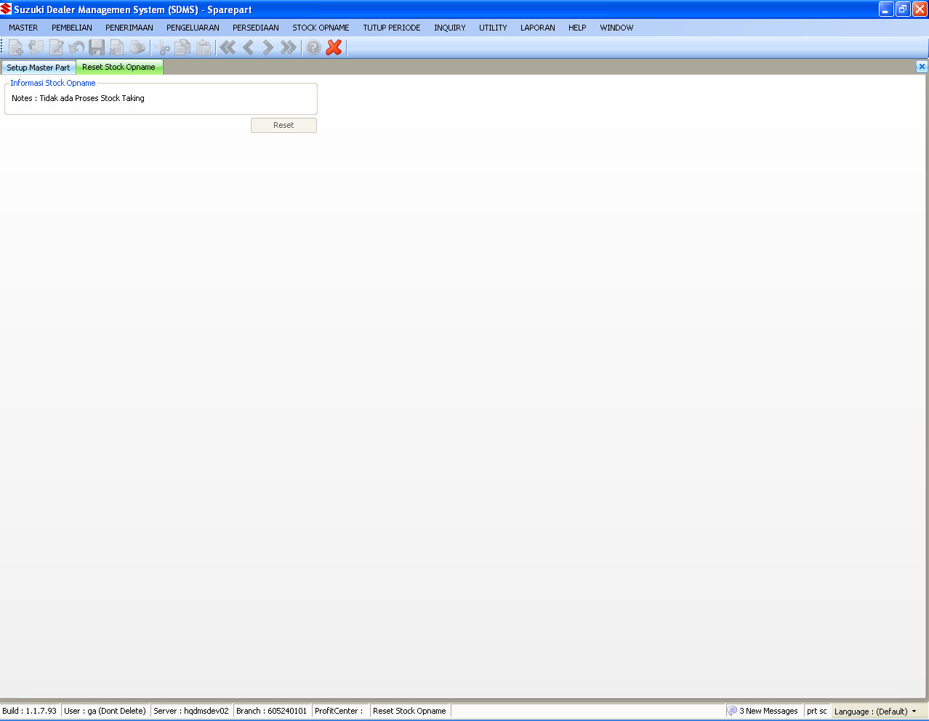
SPAREPART : UTILITY
RESET STOCK OPNAME
Notes :
Reset stock op name process with :
-. Update status SpTrnStockTakingHdr into 3
-. Delete SpTrnStockTakingTemp
-. Delete SpTrnStockTakingDtl
No updating sequence in gnMstDocument
Function : uspfn_ResetStockOpname

Slide 73
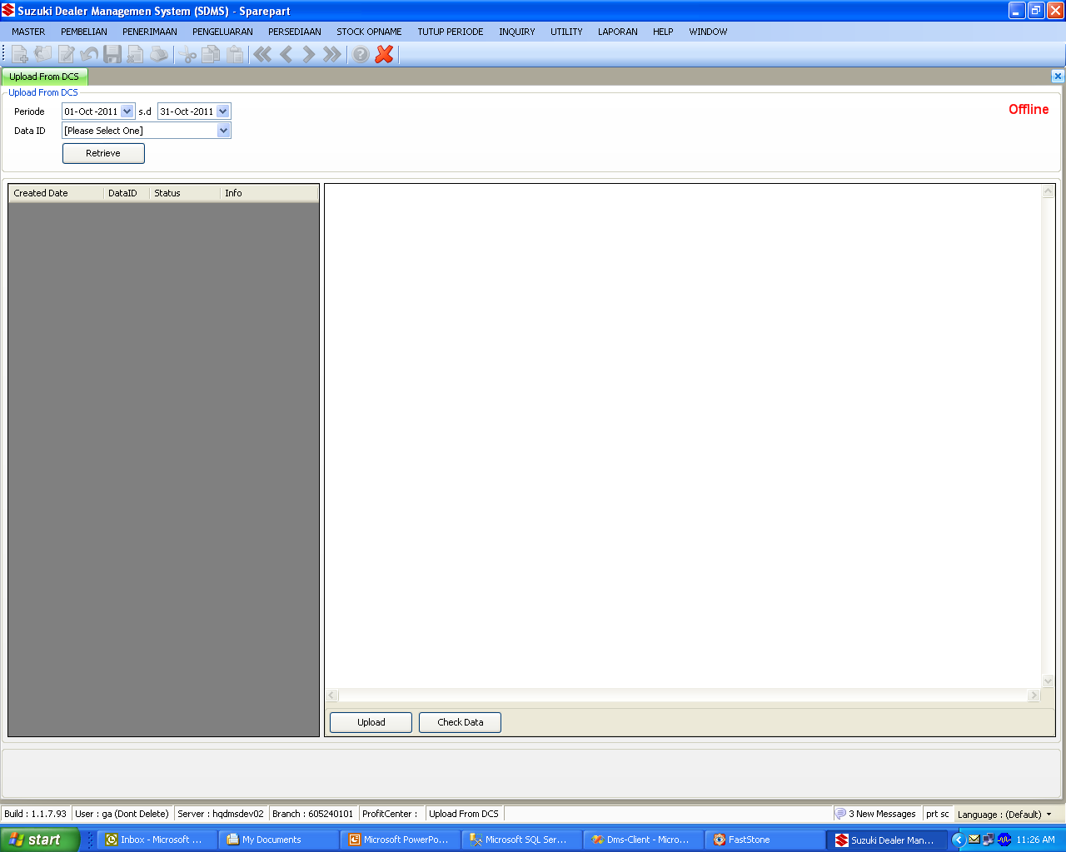
SPAREPART : UTILITY
UPLOAD FROM DCS

Slide 74
SPAREPART : UTILITY
UPLOAD FROM DCS – Continued 1
Notes :
There are several text file which can be directly downloaded from DCS with SDMS which are :
a. PINVS : Invoice Text File (PT.SIM)
b. PPRCD : Price list Text File (PT.SIM)
c. PMODP : Modification list Text File (PT.SIM)
d. PMDLM : Part Model list Text File (PT.SIM)
e. MSMDL : Master Model list Text File (PT.SIM)
Check for specification text file completely in SDMS document’s subversion Document\FLOW-DOC\01 Sparepart\08 Utility\Spareparts Domestic Flat Files.xls

Slide 75
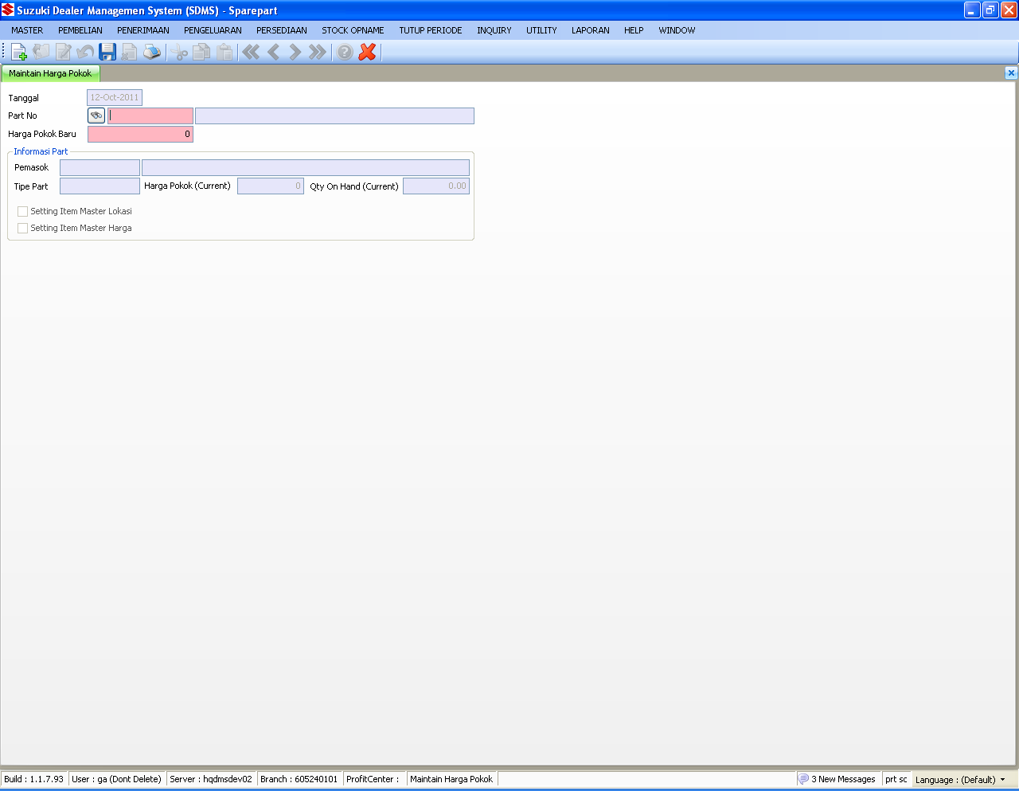
SPAREPART : UTILITY
MAINTAIN HARGA POKOK
TABLES :
SpMstItemPrice
SpHstItemPrice
Notes :
Maintenance cost price manual

Slide 76
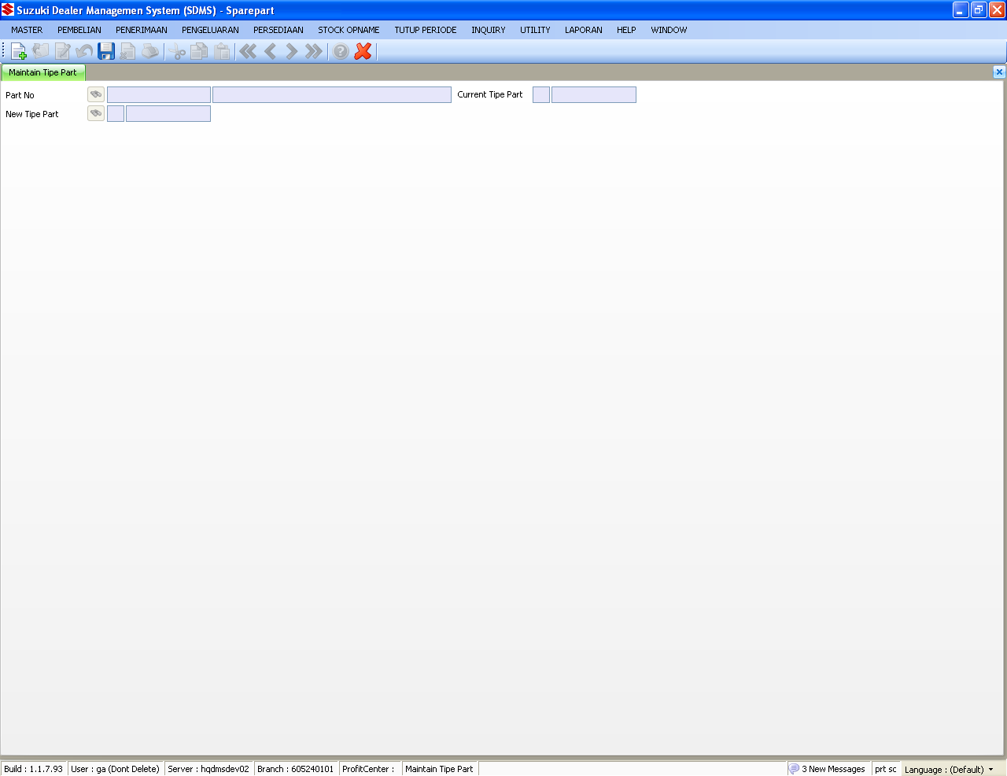
SPAREPART : UTILITY
MAINTAIN TIPE PART
TABLES :
SpMstItems
Notes :
Only holding can do the maintenance
This maintenance can be done if there is no stock left, its valid for all branch

Slide 77
QUESTION
?

Slide 78
SPAREPART : INQUIRY
Handle inquiry process related to SDMS spare part daily operations

Slide 79
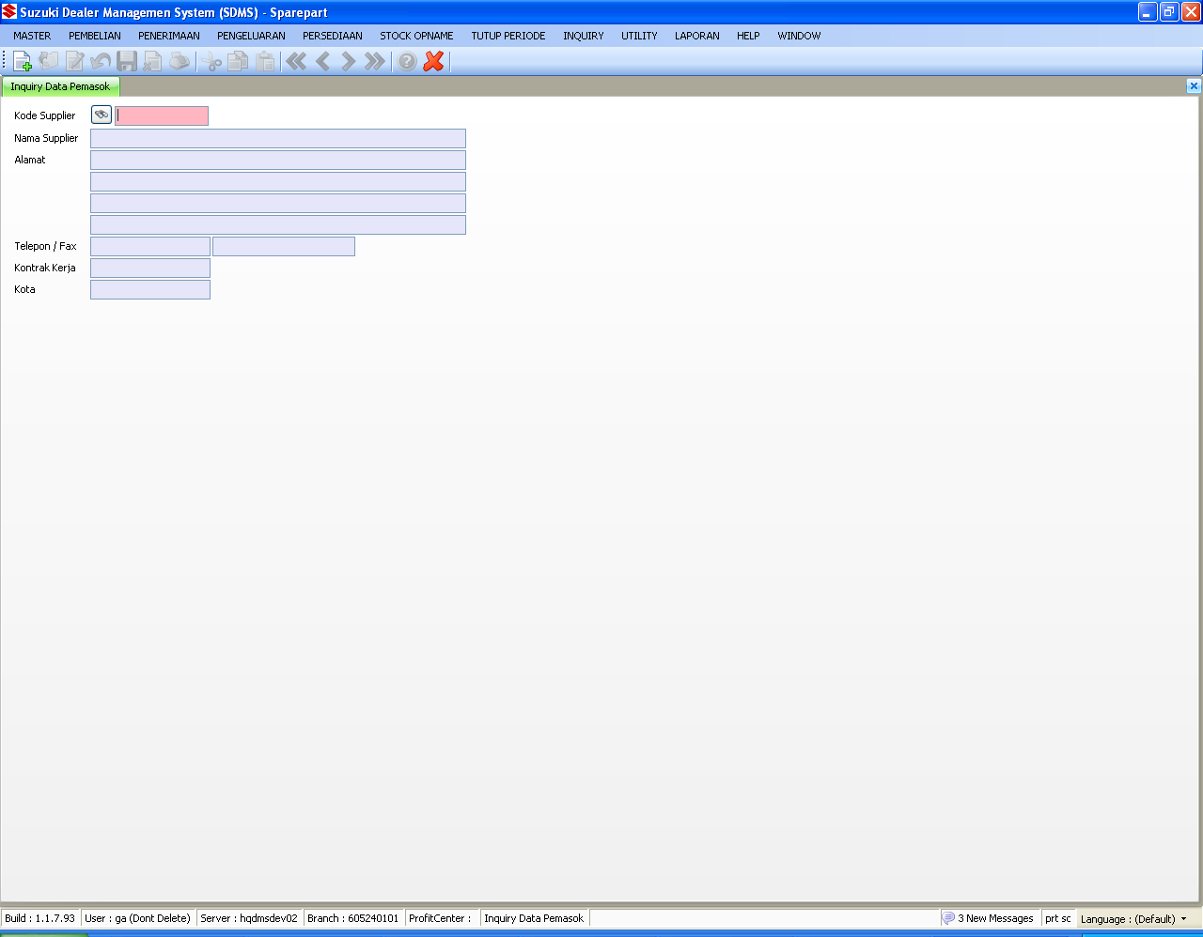
SPAREPART : UTILITY
INQUIRY DATA PEMASOK

Slide 80
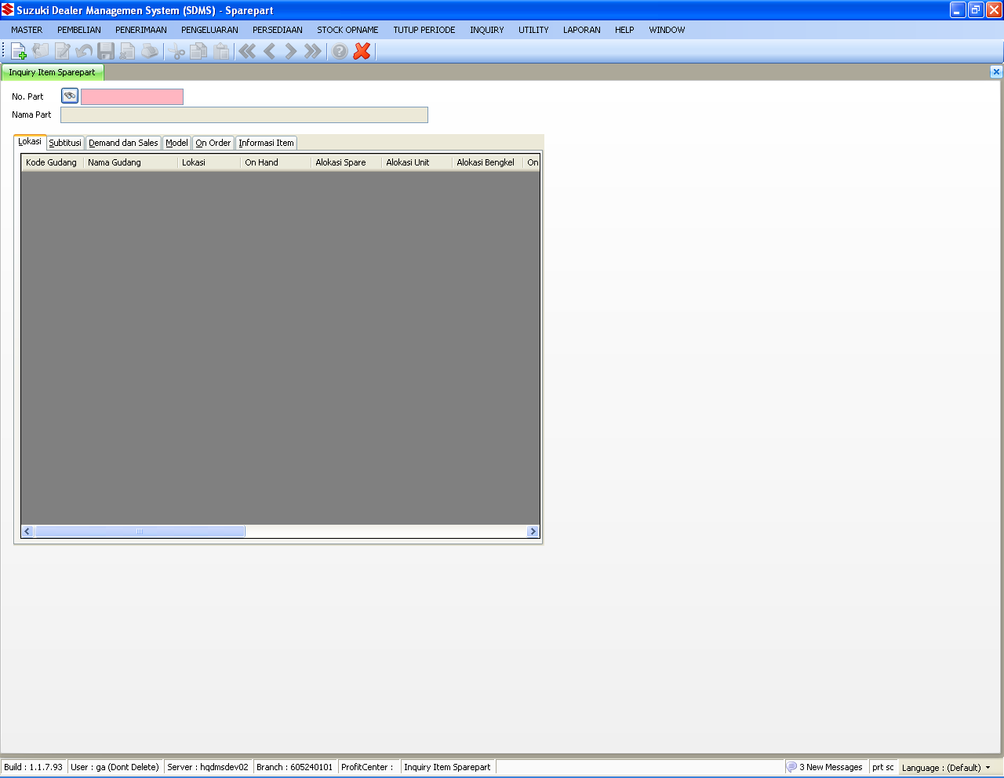
SPAREPART : UTILITY
INQUIRY ITEM SPAREPART/HQ

Slide 81
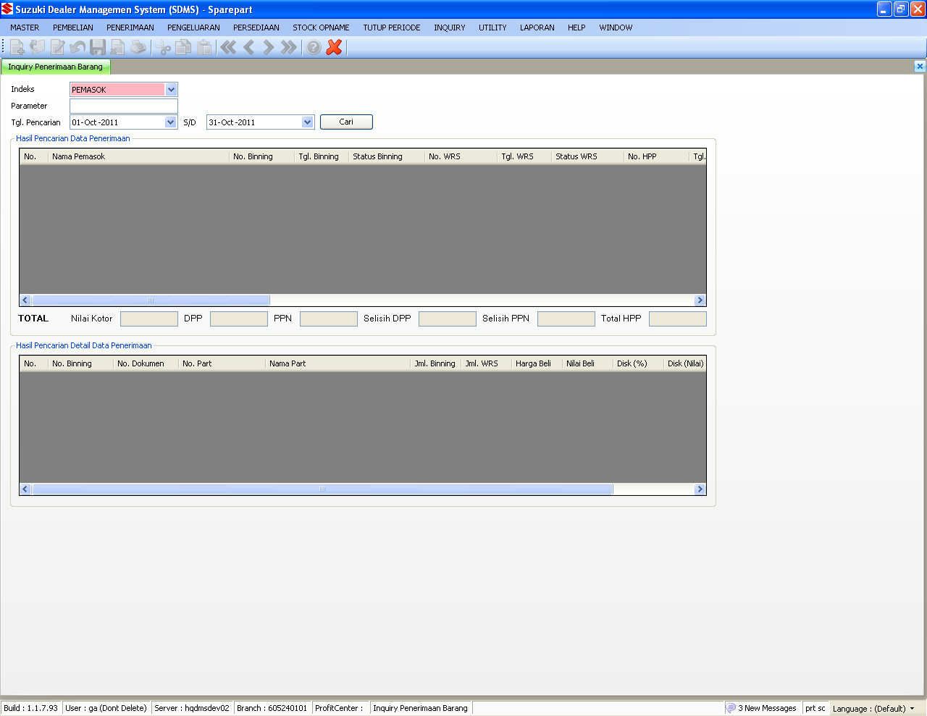
SPAREPART : UTILITY
INQUIRY PENERIMAAN BARANG

Slide 82

SPAREPART : UTILITY
INQUIRY SALES ORDER

Slide 83

SPAREPART : UTILITY
INQUIRY SUPPLY SLIP

Slide 84

SPAREPART : UTILITY
INQUIRY DATA DCS (SPAREPART)

Slide 85
QUESTION
?

Slide 86
SPAREPART : LAPORAN
SDMS spare part daily reports

Slide 87
SPAREPART : LAPORAN
MASTER
REPORT ID | STORE PROCEDURE | DESCRIPTION
SpRpMst001 | usprpt_SpRpMst001 | DAFTAR MASTER SPAREPART
SpRpMst002 | usprpt_SpRpMst002 | LIST MASTER SUBTITUSI
SpRpMst003 | usprpt_SpRpMst003 | DAFTAR OUTSTANDING PESANAN

Slide 88
SPAREPART : LAPORAN
REGISTER
REPORT ID | STORE PROCEDURE | DESCRIPTION
SpRpRgs001 | usprpt_SpRpRgs001 | REGISTER SUPPLY SLIP
SpRpRgs002 | usprpt_SpRpRgs002 | REGISTER SUPPLY SLIP OUTSTANDING
SpRpRgs002A | usprpt_SpRpRgs002ARpt | HISTORY SUPPLY SLIP OUTSTANDING
SpRpRgs003 | usprpt_SpRpRgs003 | REGISTER LAMPIRAN SERVICE/UNIT
SpRpRgs004 | usprpt_SpRpRgs004 | REGISTER PENJUALAN (TUNAI & KREDIT)
SpRpRgs005 | usprpt_SpRpRgs005 | REGISTER PENERIMAAN
SpRpRgs006 | usprpt_SpRpRgs006 | REGISTER RETUR PENJUALAN
SpRpRgs007 | usprpt_SpRpRgs007 | REGISTER SUPPLY SLIP RETURN
SpRpRgs008 | usprpt_SpRpRgs008 | REGISTER INVENTORY ADJUSTMENT
SpRpRgs009 | usprpt_SpRpRgs009 | REGISTER BON PENGELUARAN SPAREPART
SpRpRgs010 | usprpt_SpRpRgs010 | REGISTER WAREHOUSE TRANSFER
SpRpRgs011 | usprpt_SpRpRgs011 | REGISTER PENJUALAN PER PELANGGAN

Slide 89
SPAREPART : LAPORAN
REGISTER (Continued 1)
REPORT ID | STORE PROCEDURE | DESCRIPTION
SpRpRgs011A | usprpt_SpRpRgs011 | REGISTER PENJUALAN PER PELANGGAN
SpRpRgs012 | usprpt_SpRpRgs012 | REGISTER PESANAN SPAREPART
SpRpRgs013 | usprpt_SpRpRgs013 | REGISTER WAREHOUSE RECEIVING SHEET
SpRpRgs014 | usprpt_SpRpRgs014 | REGISTER CLAIM FORM
SpRpRgs015 | usprpt_SpRpRgs015 | REGISTER RECEIVED CLAIM CANCEL FORM
SpRpRgs016 | usprpt_SpRpRgs016 | REGISTER PELANGGAN YANG OVERLIMIT
SpRpRgs017 | usprpt_SpRpRgs017 | REGISTER PENJUALAN
SpRpRgs017A | usprpt_SpRpRgs017A | REGISTER PENJUALAN HOLDING
SpRpRgs017B | usprpt_SpRpRgs017B | REGISTER PENJUALAN HOLDING PER PELANGGAN
SpRpRgs018 | usprpt_SpRpRgs018 | REGISTER RETUR PENJUALAN
SpRpRgs020 | usprpt_SpRpRgs020 | DAFTAR CLAIM OUTSTANDING
SpRpRgs021 | usprpt_SpRpRgs021 | REGISTER HPP SPAREPART
SpRpRgs022 | usprpt_SpRpRgs022 | REKON SPAREPART

Slide 90
SPAREPART : LAPORAN
REGISTER (Continued 2)
REPORT ID | STORE PROCEDURE | DESCRIPTION
SpRpRgs023 | usprpt_SpRpRgs023 | REGISTER PICKING SLIP
SpRpRgs024 | usprpt_SpRpRgs024 | REGISTER BON PENGELUARAN SPAREPART OUTSTANDING
SpRpRgs025 | usprpt_SpRpRgs025 | REGISTER BON PENGELUARAN DETAIL SPAREPART OUTSTANDING
SpRpRgs027 | usprpt_SpRpRgs027 | REGISTER BON PENGELUARAN DETAIL SPAREPART
SpRpRgs028 | usprpt_SpRpRgs028 | REGISTER SUPPLY SLIP (HOLDING)
SpRpRgs029 | usprpt_SpRpRgs029 | REGISTER PERUBAHAN AVERAGE COST

Slide 91
SPAREPART : LAPORAN
SUMMARY
REPORT ID | STORE PROCEDURE | DESCRIPTION
SpRpSum001 | usprpt_SpRpSum001 | KARTU STOCK
SpRpSum002 | usprpt_SpRpSum002 | DAFTAR ITEM DENGAN PENJUALAN TERBAIK
SpRpSum003 | usprpt_SpRpSum003 | LAPORAN ANALISA SERVICE RATIO PER PELANGGAN
SpRpSum004 | usprpt_SpRpSum003 | RINGKASAN SERVICE RATIO
SpRpSum005 | usprpt_SpRpSum005 | LAPORAN PENJUALAN PER PELANGGAN
SpRpSum006 | usprpt_SpRpSum006 | DAFTAR BARANG YANG DIPINJAM
SpRpSum007 | usprpt_SpRpSum007 | DAFTAR BARANG YANG HARUS DIKEMBALIKAN
SpRpSum008 | usprpt_SpRpSum008 | DAFTAR PERUBAHAN HARGA POTONGAN, HARGA BELI & HARGA JUAL
SpRpSum009 | usprpt_SpRpSum009 | DAFTAR PERUBAHAN AVERAGE COST
SpRpSum010 | usprpt_SpRpSum010 | DAFTAR PAJAK KELUARAN

Slide 92
SPAREPART : LAPORAN
SUMMARY (Continued 1)
REPORT ID | STORE PROCEDURE | DESCRIPTION
SpRpSum011 | usprpt_SpRpSum011 | DAFTAR PART PER NO PART
SpRpSum012 | usprpt_SpRpRgs003 | LAMPIRAN FAKTUR
SpRpSum013 | usprpt_SpRpSum013 | LAPORAN PENJUALAN PER CLASS, AREA, KOTA DAN LOKASI
SpRpSum014 | usprpt_SpRpSum014 | LAPORAN AKTIVITAS TRANSAKSI
SpRpSum015 | usprpt_SpRpSum015 | DAFTAR OVER STOCK
SpRpSum016 | usprpt_SpRpSum001 | K A R T U S T O C K
SpRpSum017 | usprpt_SpRpSum013 | LAPORAN PENJUALAN PER CLASS, AREA, KOTA DAN LOKASI
SpRpSum019A | usprpt_SpRpSum019A | LAPORAN LABA RUGI SPAREPART
SpRpSum020 | usprpt_SpRpSum020 | REKAPITULASI OMZET

Slide 93
SPAREPART : LAPORAN
POSTING BULANAN
REPORT ID | STORE PROCEDURE | DESCRIPTION
SpRpTrn017 | usprpt_SpRpTrn017 | ANALISA SPAREPART MENURUT ABC CLASS
SpRpTrn018 | usprpt_SpRpTrn018 | ANALISA SPAREPART MENURUT MOVING CODE
SpRpTrn019 | usprpt_SpRpTrn019 | MUTASI STOCK BULANAN

Slide 94
QUESTION
?

Slide 95
SPAREPART : CONFIGURATION
Configuration SDMS spare part for daily operations

Slide 96
SPAREPART : CONFIGURATION
Notes :
SETTING DCS
GnMstLookupDtl : CodeID = PORDS : Paravalue = 1 (AKTIF) 0 (NON AKTIF)
AKTIF → Using lockingby (GnMstCoProfileSpare) as kode dealer
NON AKTIF → Using companycode as kode dealer
GENERATE WRS FROM BINNING
GnMstCoProfileSpare : IsLinkWRS : TRUE (1) AKTIF FALSE (0) NON AKTIF
REPORT NETT PRICE AND GROUPING SALES NO FOR FAKTUR PENJUALAN
GnMstLookUpDtl : CodeID = FLPG : Paravalue = 1 (AKTIF) 0 (NON AKTIF)
AKTIF → using nett price and grouping sales no
NON AKTIF → using standard report

Slide 97

THANK YOU
I hope this information will be useful

